Slide 1
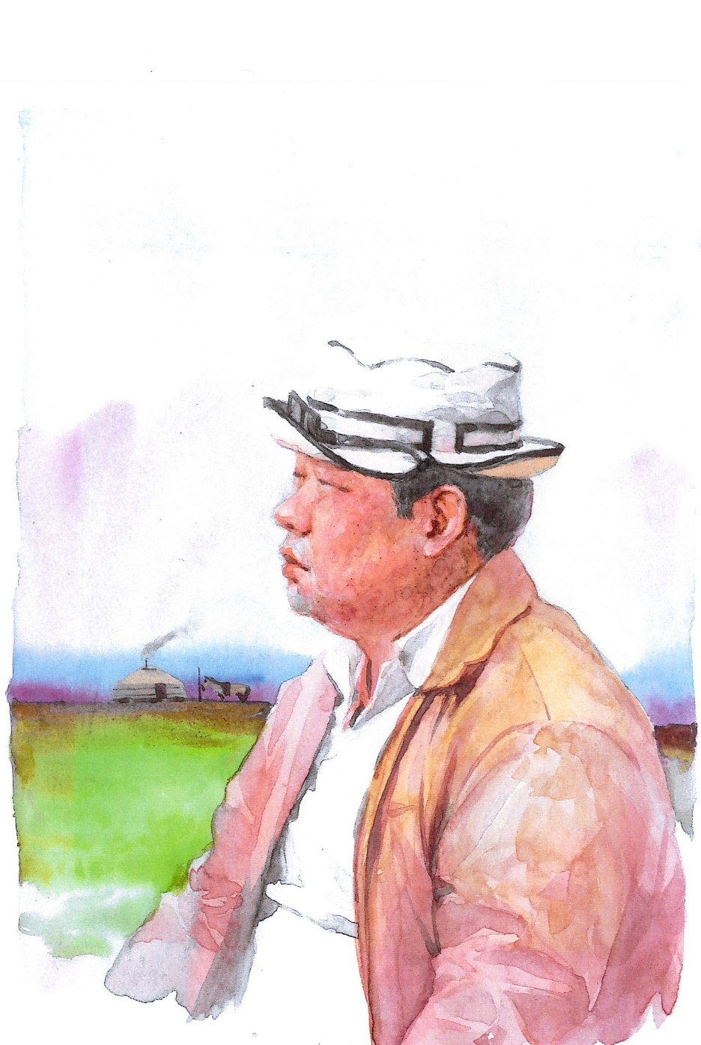
Trans-Altai Sustainability Dialogue : Peace, Justice, and Strong Institutions
The Archaeological Type
of Sambyeolcho,
Goryeo Dynasty
in Korean Peninsula
and the Route of
Mongol Empire Military Force
윤 형 원(국립김해박물관장)
Yun Hyeung-won (Yundorj)
ㅇ Director,
The Gimhae National Museum of Korea
ㅇ Previous Chairman(2019-2022),
The Korean Association
for Central Asian Studies(KACAS)
Doctor of Honor (2008, Institute of Archaeology, Mongol Academy of Sciences)
Deploma of Honor (2010, Mongol Academy of Sciences)
The Order of Polar Star (Altan-Gadas, 2022, President of Mongolia)

Slide 2
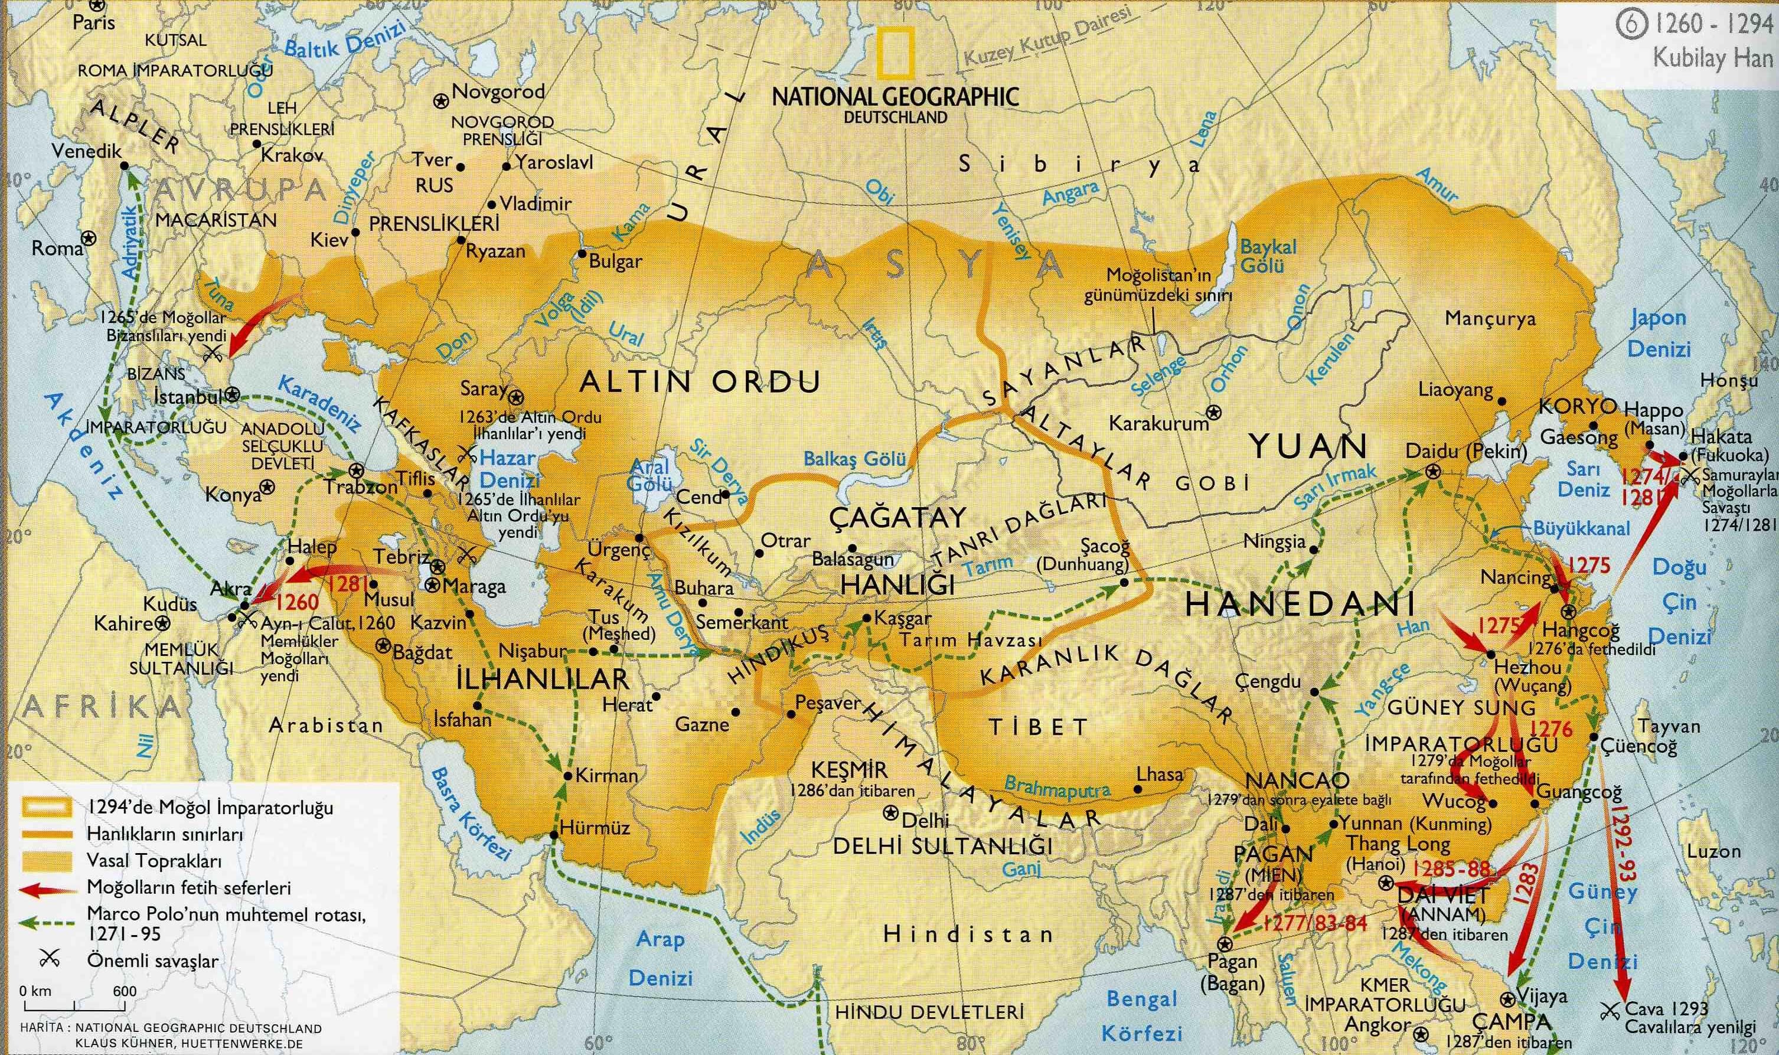
Greek-Roma
Hunnu
Senbi
N
Egypt
Han
Persia
Viet

Slide 3
ABSTRACT
Sambyeolcho, Goryeo Dynasty related with Mongol Empire Military Force, the events that took place at Gaegyeong-Ganghwa Island-Jindo Island-Jeju Island-Ryukyu take on the aspect of an international war. This subject is proceeding for long time on archeological excavation and historical resesrch in Korea. What is a real shape of Goryeo, according to interpretate Sambyeolcho and Maritime route of Korean peninsula. Anaysis archaeological artifacts and historical records.
몽골(元)
칭기스칸 때 초원 유목사회를 통합
육상교통의 정치․군사적인 장애물을 제거
‘팍스 몽골리카나’라고 하는 동서남북을 망라하는 평화를 기반으로 하는 교역의 전기
빠른 기병과 뛰어난 전술을 자랑하는 몽골군단의 등장 : 현대 축구에 비교한다면 ‘토탈 사커’의 출현과 비교

Slide 4
Synthsis archaeological-historical perspective. This research is nassasary that it reveal hidden Goryeo-Mongol culture and new medieval Korean Maritime route. And it is related with Mongol-Goryeo-Japan military force.The archaeological remains that show the Mongol Empire(元, Yuan Dynasty)’s active maritime route is the Sinan shipwreck 701 years before. It was a trading ship going from Ningbo(寧波), in 1323.
Keyword: Goryeo Dynasty, Sambyeolcho, Mongol Empire(元, Yuan Dynasty), Sinan Shipwreck 701 years

Slide 5
INTRODUCTION
Mongol Empire (Chinese branch Yuan Dynasty) in the time of Genghis Khan, the steppe nomadic society was unified. Political and military obstacles to land transportation have been removed. A turning point in trade based on peace covering the north, south, east, and west called ‘PAX MONGOLICANA’ was prepared. The emergence of the Mongol Legion, which boasts fast cavalry and excellent tactics, can be compared to the emergence of ‘Total Soccer’ in modern football.

Slide 6
There was a perception that the appearance of the Mongol Corps was 'the world's strongest on land, but not so much on the sea...’. During the Goryeo Dynasty, the military authority moved the capital to Ganghwa Island, The Sambyeolcho fought in Jindo Island and Jeju Island. There are also traces of movement from Jeju Island to Ryukyu (now Okinawa). Kublai Khan (元世祖) encompassed the continent and conquered the Southern Song; he was well aware of the economic benefits of maritime trade, and had great interest in maritime management.

Slide 7
Kublai Khan sent edicts to Asian countries encouraging them to trade. He carried out maritime military expeditions to Japan and Southeast Asia (Annam, Champa <now Vietnam> ․ Java <now Indonesia>). As a result, Yuan's trading spheres were greatly expanded. He supports the Saekmok people (色目人), who were well versed in finance and trade during the Southern Song Dynasty, to continue their maritime activities, A state-owned ranch (one of 14 in the Mongol Empire) was established in Jeju Island and used as a bridgehead for maritime expansion.

Slide 8
THE EXPEDITION OF MONGOL ARMY AND THE MARITIME ROUTE OF SAMBYEOLCHO
Historical background
Mongol Expedition to Goryeo was in 1215, when the Mongols entered Goryeo for the first time. In 1225, the Mongol envoy Jeo Go-yeo was murdered. From 1231 to 1259, there were major six invasions in Goryeo. In 1255, the Mongolian army organized a naval force and fought in Aphae Island with about 70 warships.

Slide 9
After the Sambyeolcho's resistance in 1273, Jeju Island became a direct Mongol territory. The Sambyeolcho In 1270, they led about 1,000 ships from Ganghwa Island and moved south, focusing on Jindo Island. In 1271, when the Jindo Island front line was collapsed, they moved the centre to Jeju and worked there. In 1273, part of the Sambyeolcho moved from Jeju to Ryukyu (now Okinawa). The Goryeocheopjangbulsimjojo (高麗牒狀不審條條; Tokyo University Historical Archives), which contains notes on the contents of the correspondence sent to Japan from the Sambyeolcho, Jindo Island, remains. It did not get any help.
몽골군단의 모습은 ‘육상에서는 세계 최강이나 해상에서는 별로...’라는 인식
고려때 무신정권은 강화도로 천도,
삼별초는 진도와 제주도에서 항전
제주도에서 류큐(현 오키나와)로 이동 흔적
쿠빌라이 칸(元世祖)은 대륙을 아우르고 남송을 정복하였고 해양무역의 경제적 이익을 잘 알고 있었으며 해양경영에 큰 관심
쿠빌라이 칸은 아시아 각국에 칙서를 보내 무역할 것을 권유함
일본과 동남아(안남 ․ 참파<현 베트남> ․ 자바<현 인도네시아>) 등에 해상 군사원정
->원(元)의 무역권이 크게 확대되는 성과
남송(南宋)때 활동하던 재정과 무역에 정통한 색목인들이 해양활동을 계속하도록 지원
제주도에 국영목장(몽골 전체 14곳 중 하나)을 설치하고 해양진출의 교두보로 삼음
가. 몽골의 고려원정
1215년 몽골이 처음으로 고려에 들어옴
1225년 몽골사신 저고여 피살사건 발생
1231년부터 1259년까지 크게 6차 침공
1255년 몽골군은 수군을 편성하여 70여척의 군선으로 압해도에서 전투를 벌임
1273년 삼별초의 항전 후 제주도는 몽골(元) 직할령
1270년 강화도에서 1,000여척의 배를 이끌고 진도를 중심으로 활동
1271년 진도에서 제주로 옮겨 활동
1273년 제주에서 류큐(현 오키나와)로 이동
진도 삼별초에서 일본에 보낸 서신내용을 메모한「고려첩장불심조조(高麗牒狀不審條條)」(도쿄대학사료편찬소)기록 : 몽골의 일본공격 경고, 식량 병력 협조요청
1255년 6차 침공시 몽골군은 수군을 편성 70여척의 군선으로 압해도 전투기록
Ⅲ. 맺음말
몽골(元)이 해양경영에서 얻어지는 막대한 실리를 마다하지 않았음은 분명하다. 다만, 오늘날의 우리는 ‘오랜 초원생활에 익숙한 유목민들이...’, ‘인구로도 얼마되지 않는 유목민들이...’ 라는 선입관을 가지고 있을 뿐이다. 몽골의 글로벌한 경영은 점령지의 종족들을 다시 조직화하여 몽골의 일원으로 활동하게 한다. 그것이 군대이든 무역상이든 기술자이든 모두 몽골의 일원으로 복무하게 하는 것이다. 일본원정에 나선 고려의 여몽연합군이 그러했고 남송의 범문호를 비롯한 10만 장병들이 그러했다. 또한, 남송 때부터 활동하던 색목인들을 우대하여 무역에 종사할 수 있도록 국가에서 적극 지원하였다. 아울러 해양경영에 있어 제주도를 직할지로 삼아 교두보를 확보하고 해양강국을 위한 노력을 극대화시켰다.

Slide 10
After conquering the stronghold of Sambyeolcho in 1273, the Yuan Dynasty changed the name of the island to Jeju, meaning ‘a place where everything is perfect’. They installed the Tamra General Headquarters and dispatched Darughachi directly to station troops and set up army agriculture, called dunjeon (屯田). The Mongols’ direct administration of Jeju Island played a role in raising horses, building ships, preparing for the Japanese expedition, and monitoring the Goryeo court and troops.

Slide 11
The Mongols’ dominance over Jeju Island had lasted for 98 years until the ‘Mok-ho Rebellion’ broke out in 1374 in the 23rd year of King Gongmin’s reign and was suppressed by General Choe Yeong.

Slide 14
Archaeological types of Goryeo Sambyeolcho
Ganghwa Island Fortress
Ganghwa Island in the Ganghwa period had an outer and a middle structure, and although there was no record of construction, it was a triple structure with an inner structure. The Ganghwa Jungseong (Middle Structure) Fortress was first excavated in 2009, and the construction process is largely based on foundation formation and inner waterway

Slide 15
formation → stylobate stone churn formation → center plinth mound formation after lumber facility installation → cladding formation → inner and outer mound embankment → outer skin. It can be classified according to the composition of the soil. Thirteen building sites were identified in the Okrim-ri area, and a large number of roof tiles and celadon were jointly excavated.

Slide 16
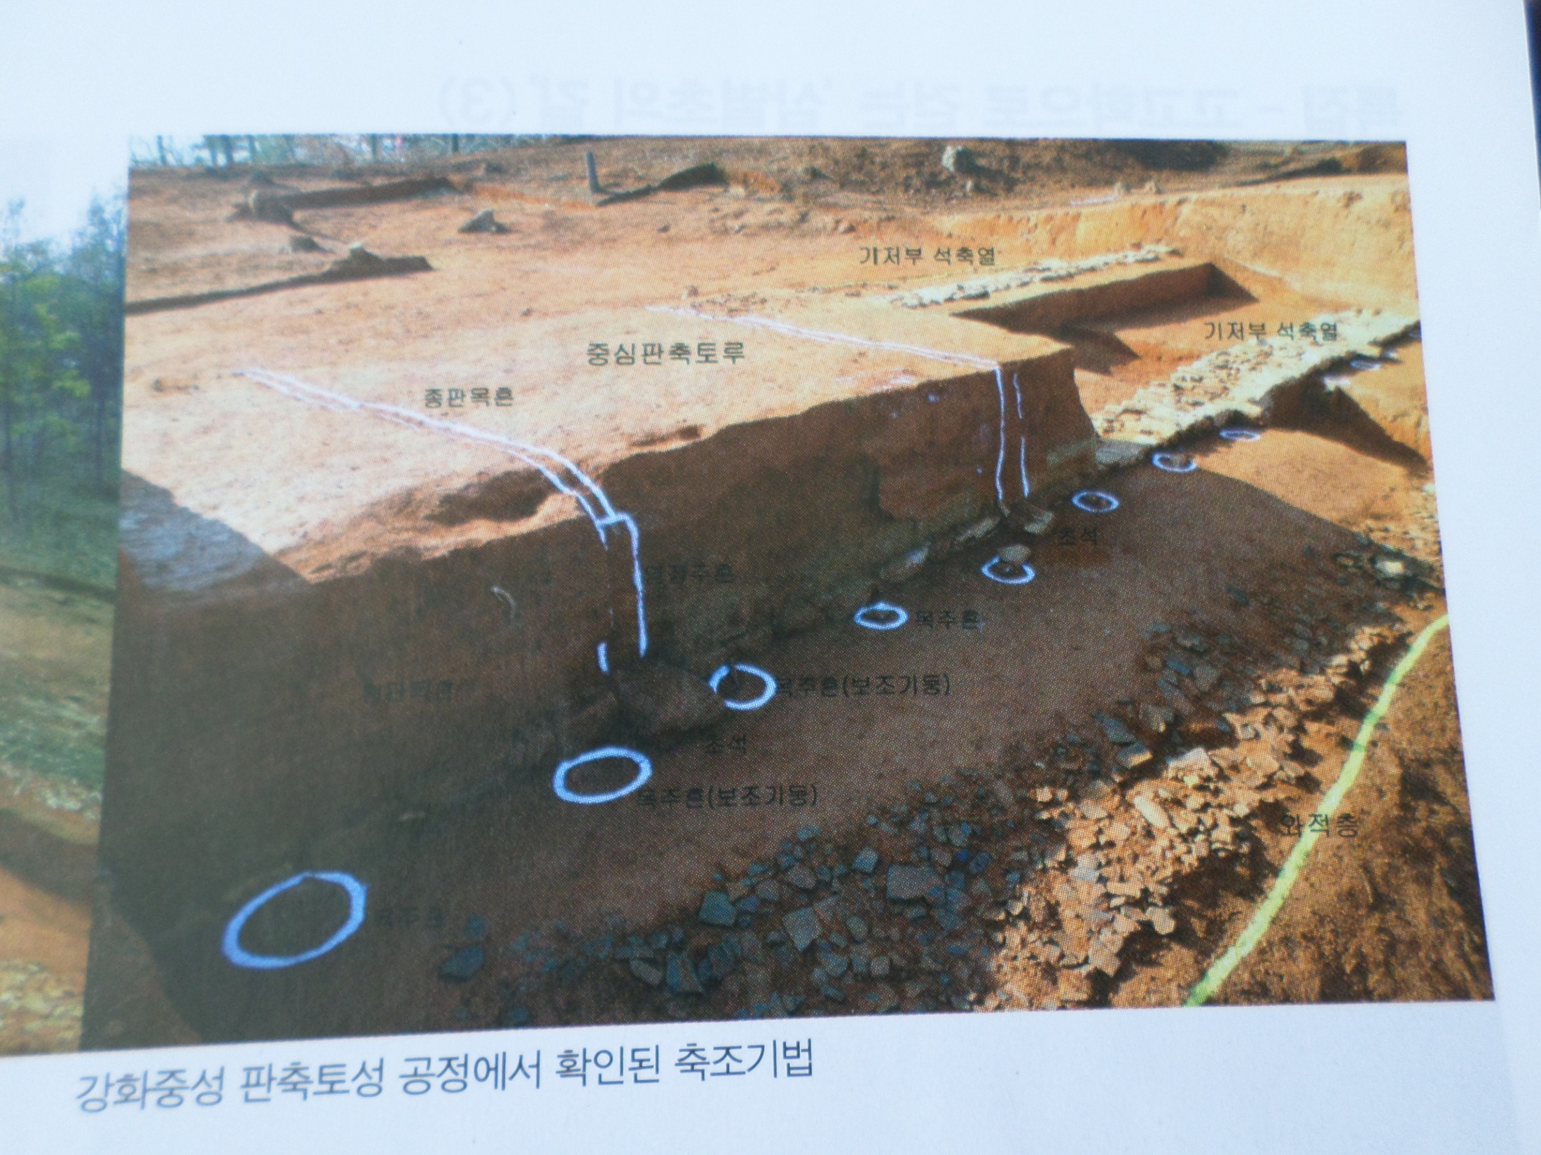

Slide 17
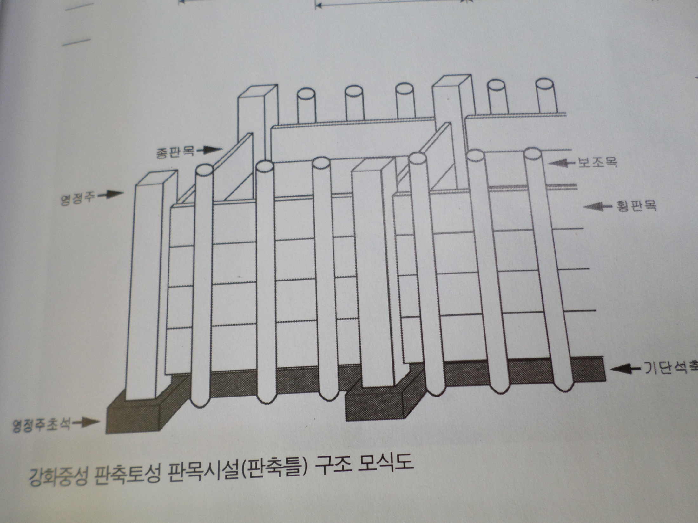

Slide 18
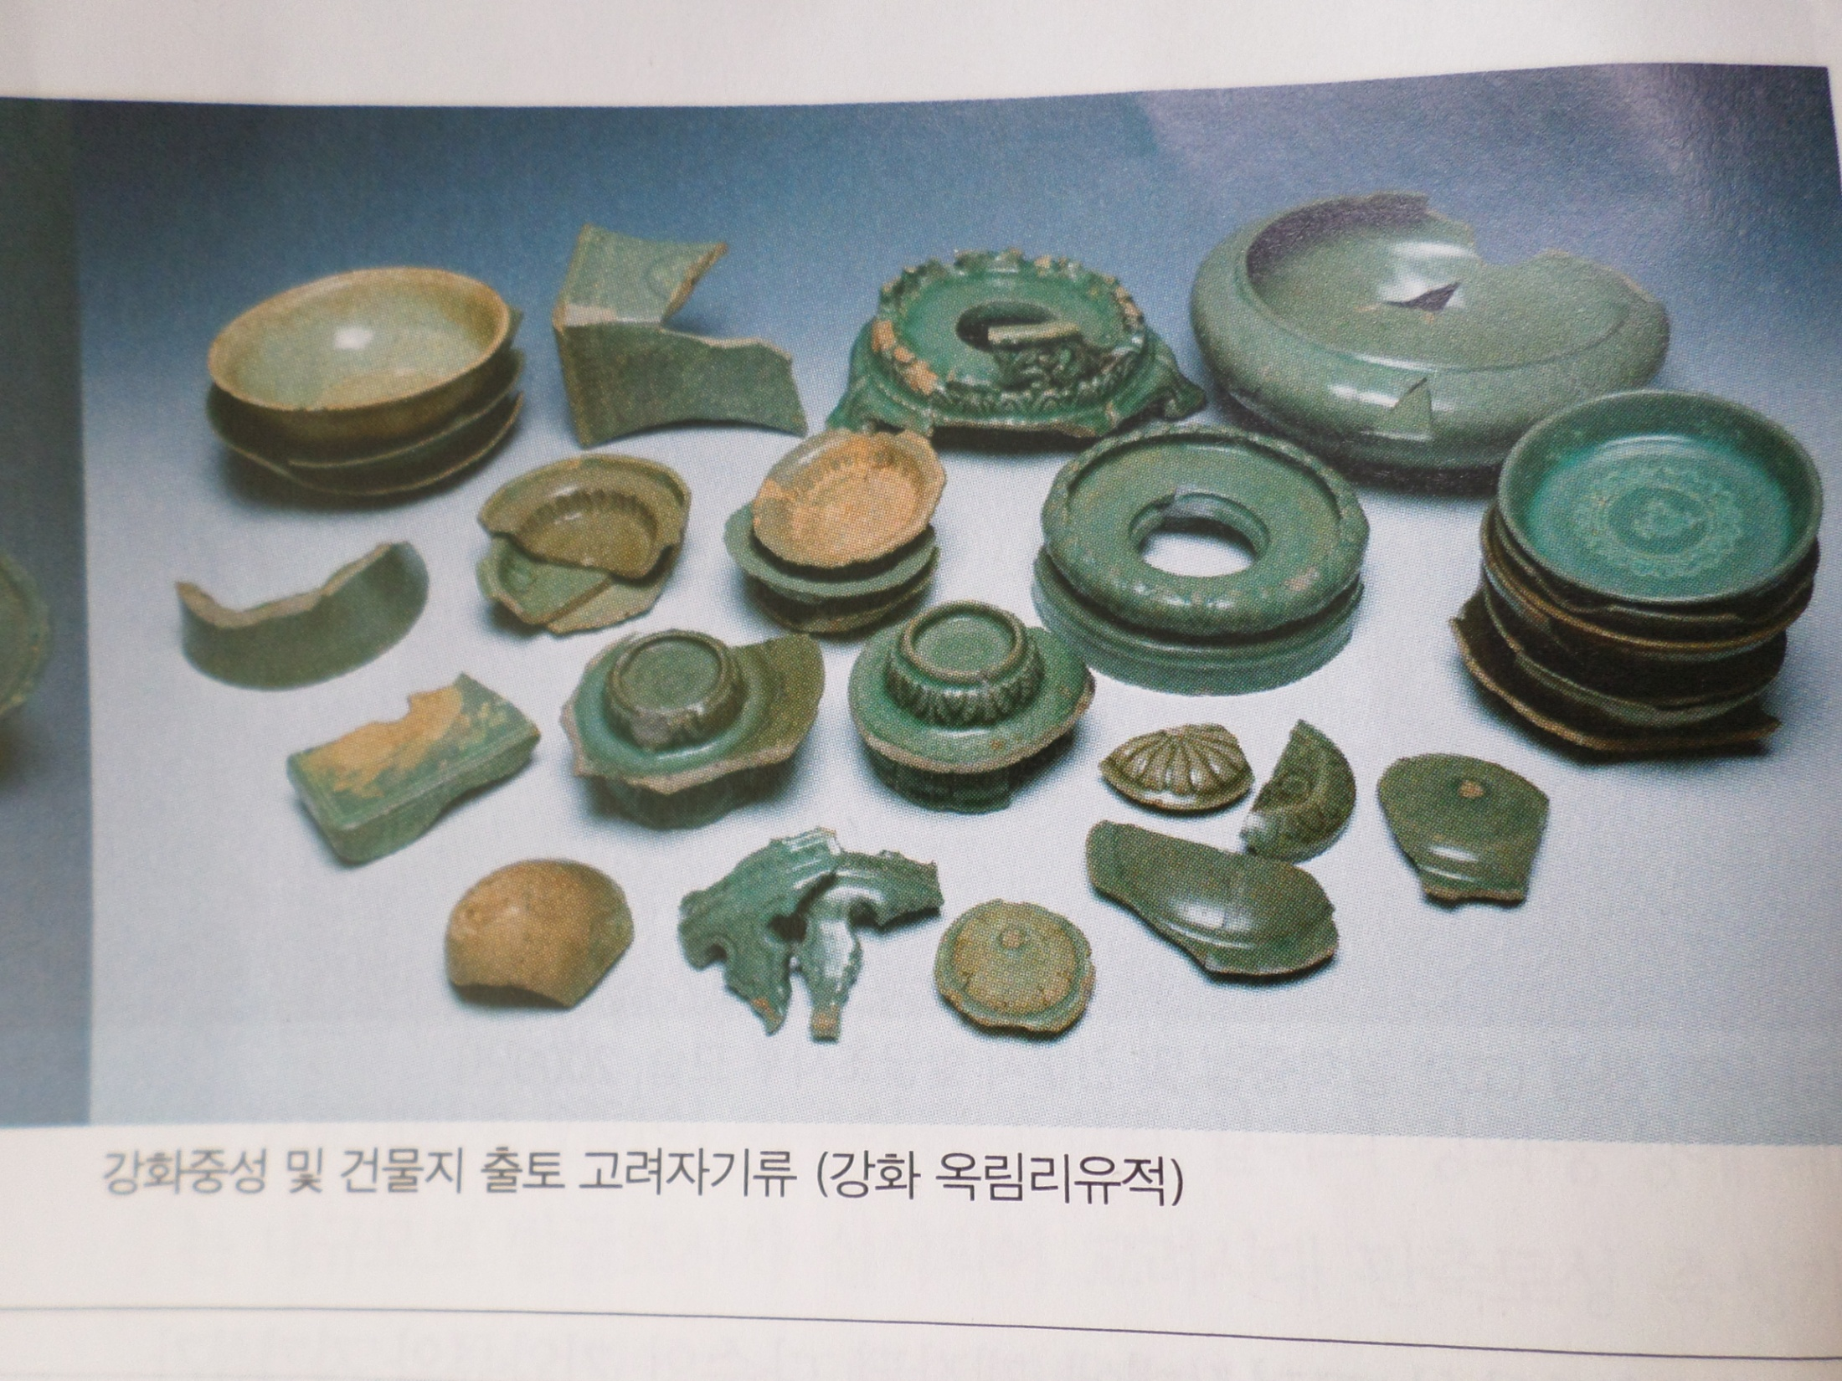

Slide 19
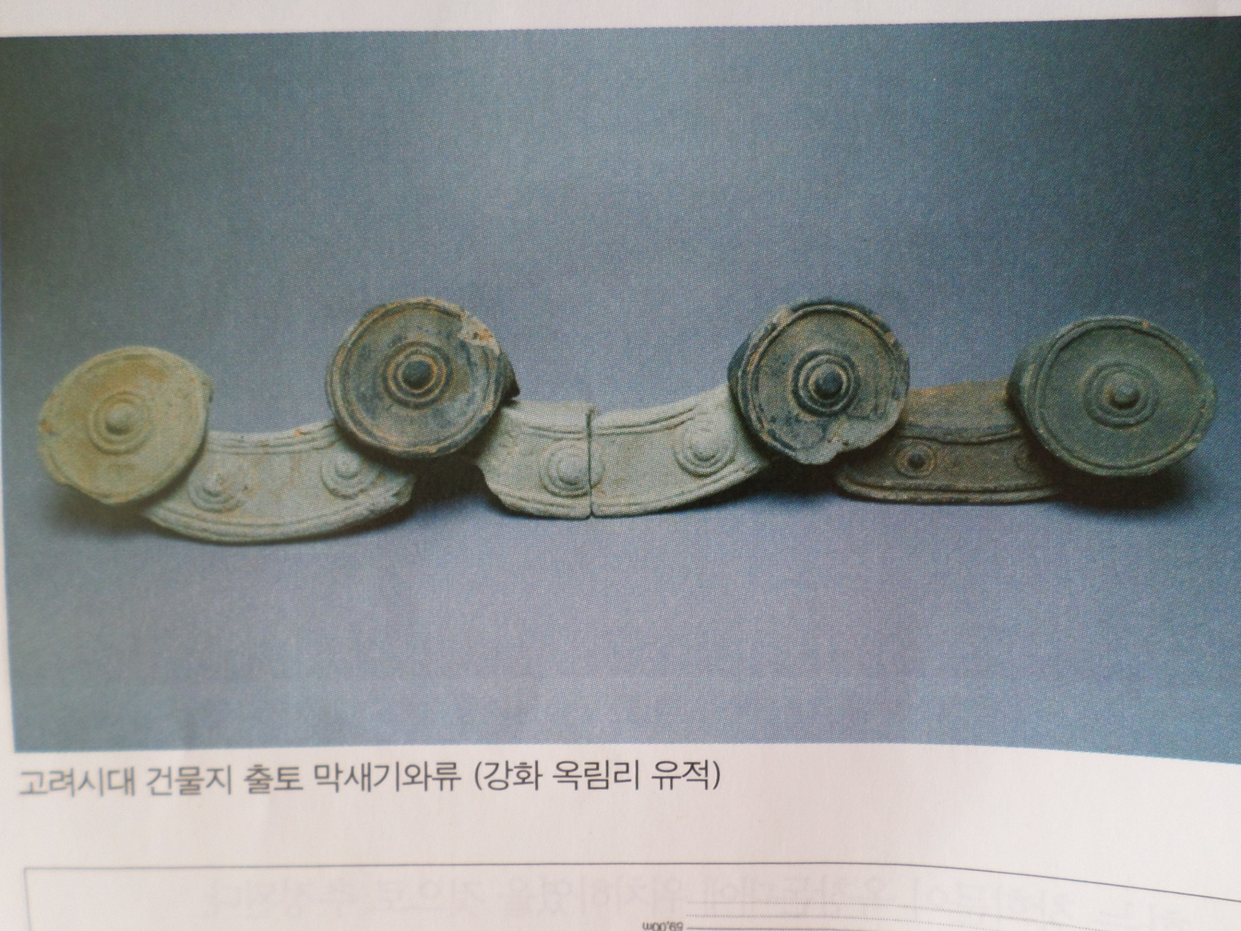

Slide 20
Jindo Yongjangseong Fortress
It was designated as Historic Site No. 126 in 1964. In the 1980s, it was known that it is a double castle structure of gungseong (palace) or naeseong (inner wall castle), and naseong (outer wall castle); additionally, in 1989, the central part was investigated. In 2004, a survey of the city walls, gates, and ancestral rites was conducted. Full-scale excavations had been conducted from 2009 to 2015. In 1270, Sambyeolcho appointed Seunghwahu ‘On’ as king and established a new government. Yongjangseong Fortress was operated with the concept of a capital city, and its shape resembles the structure of Manwoldae in Gaeseong.

Slide 21
Yongjangsanseong Fortress as naseong, is 13 km long and is a stone-built structure built by the Hyeopchukbeop-a method of building the inner and outer walls with stone. Excavated artifacts include celadon incense burners, celadon chair (don), bronze utensils, Gwangmyeongdae, and various roof tiles. In particular, roof tiles from 「癸卯三月大匠蕙印」 have been excavated from Sadang-ri, Gangjin, Cheonghaejin·Beophwasa Temple Site, Wando Island, and building sites in Sinyong-ri, Apahae Island, Sinan. It is understood that Yongjangseong Fortress was built before entering Jindo Island. In the underwater excavation at Oryu-ri in the Myeongnyangdaecheop Sea area of Jindo Island, pottery and bottles (‘蒙古甁’, 褐釉四長耳壺) from the Yuan Dynasty were also found.

Slide 22
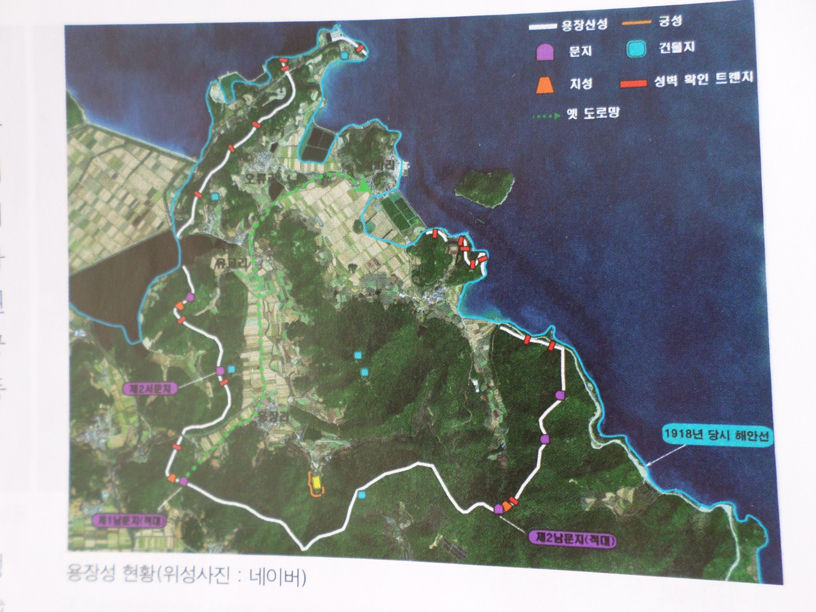

Slide 24
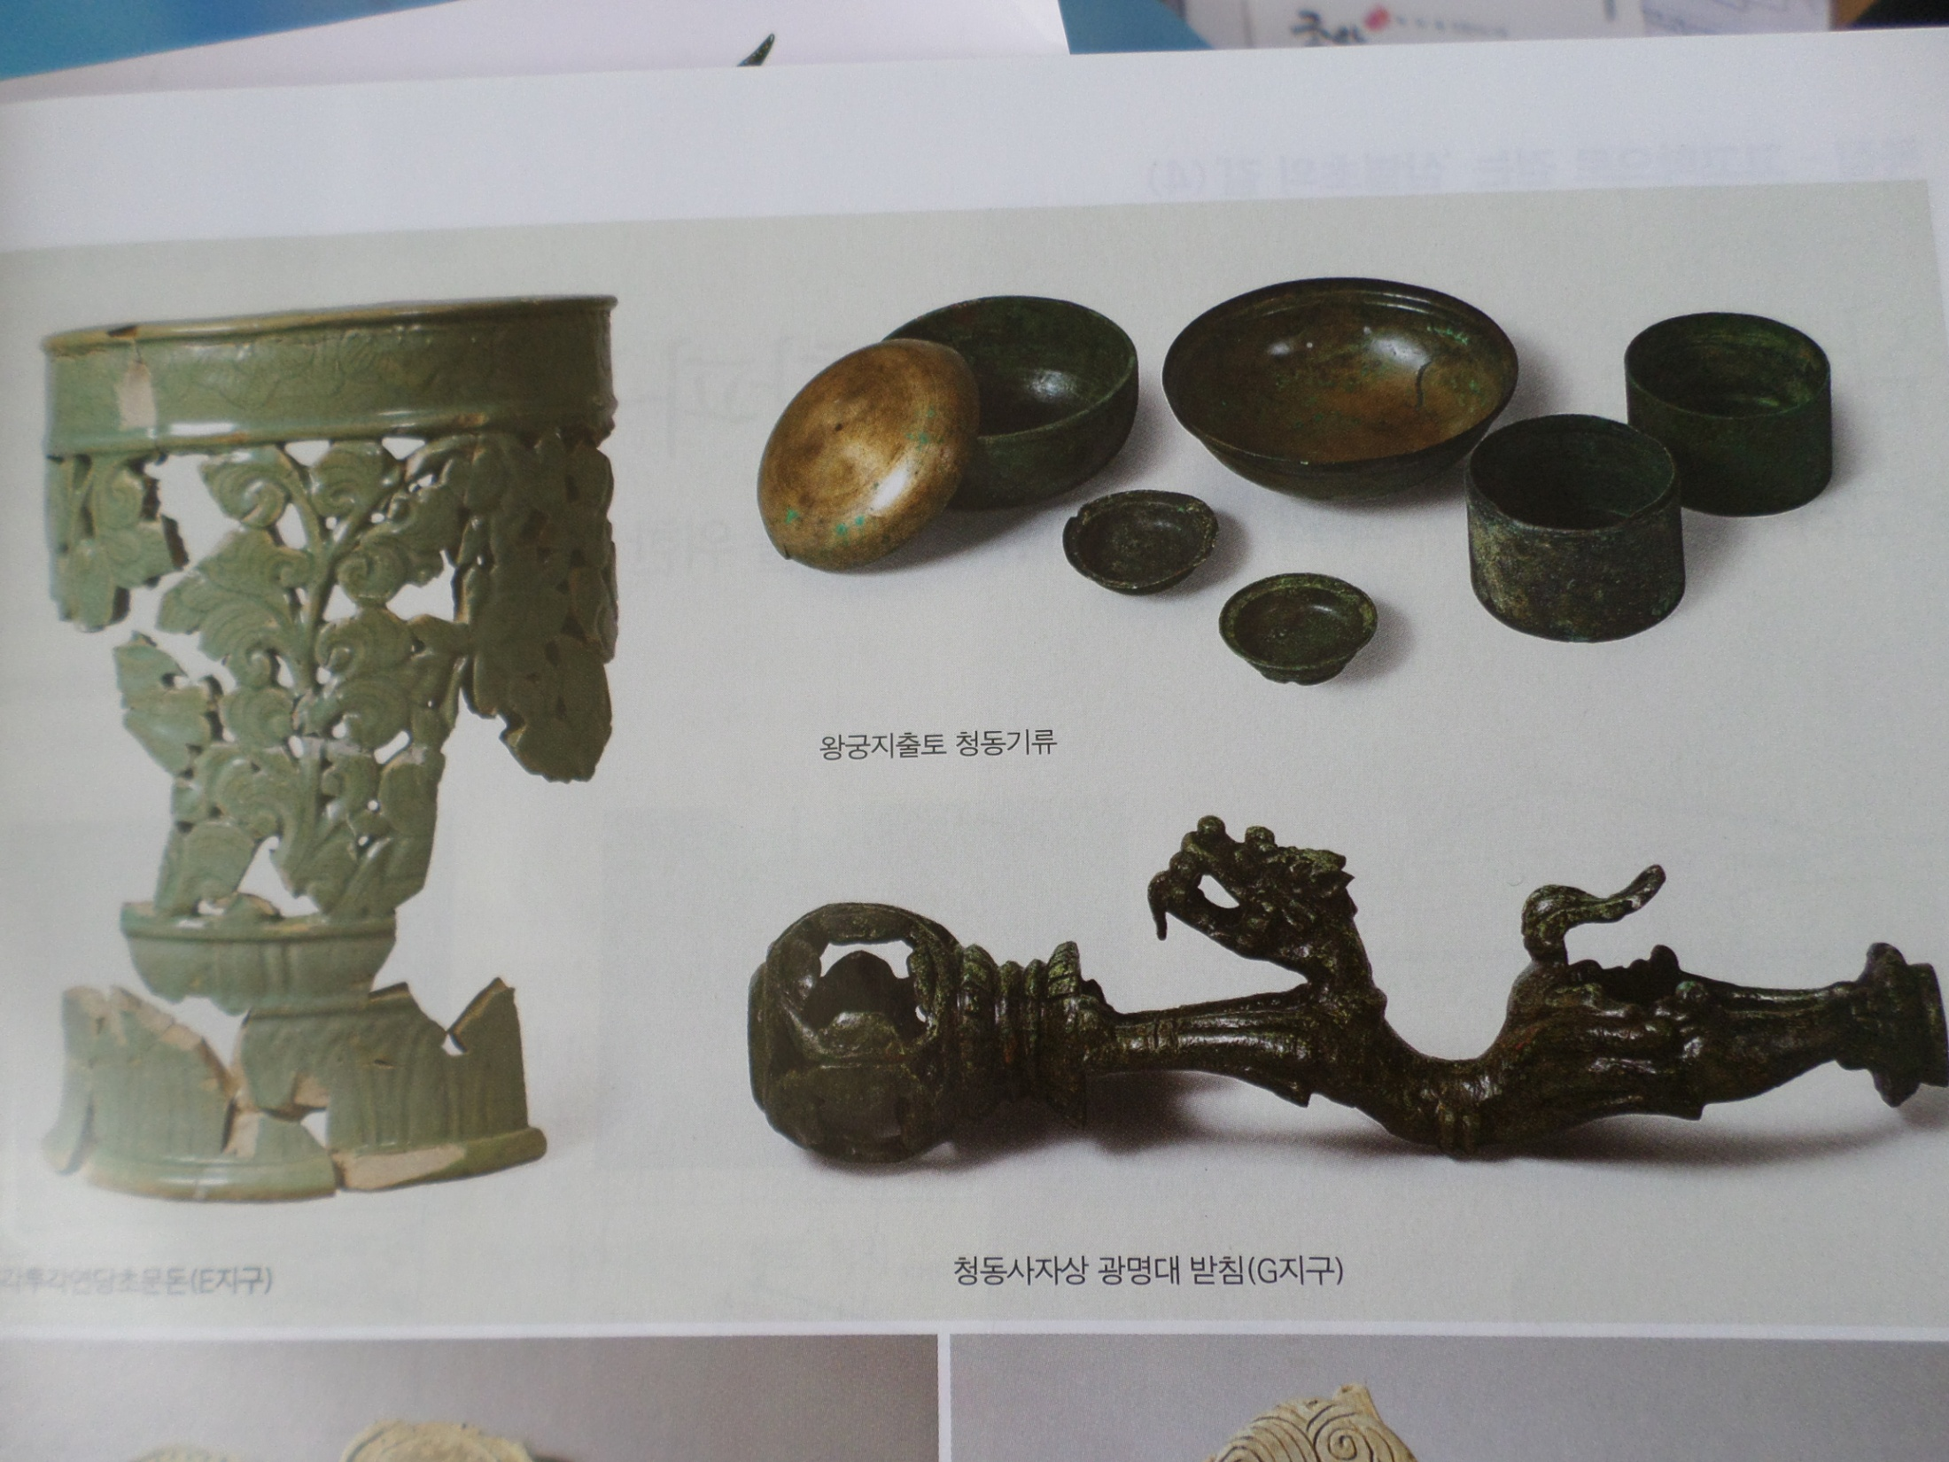

Slide 25
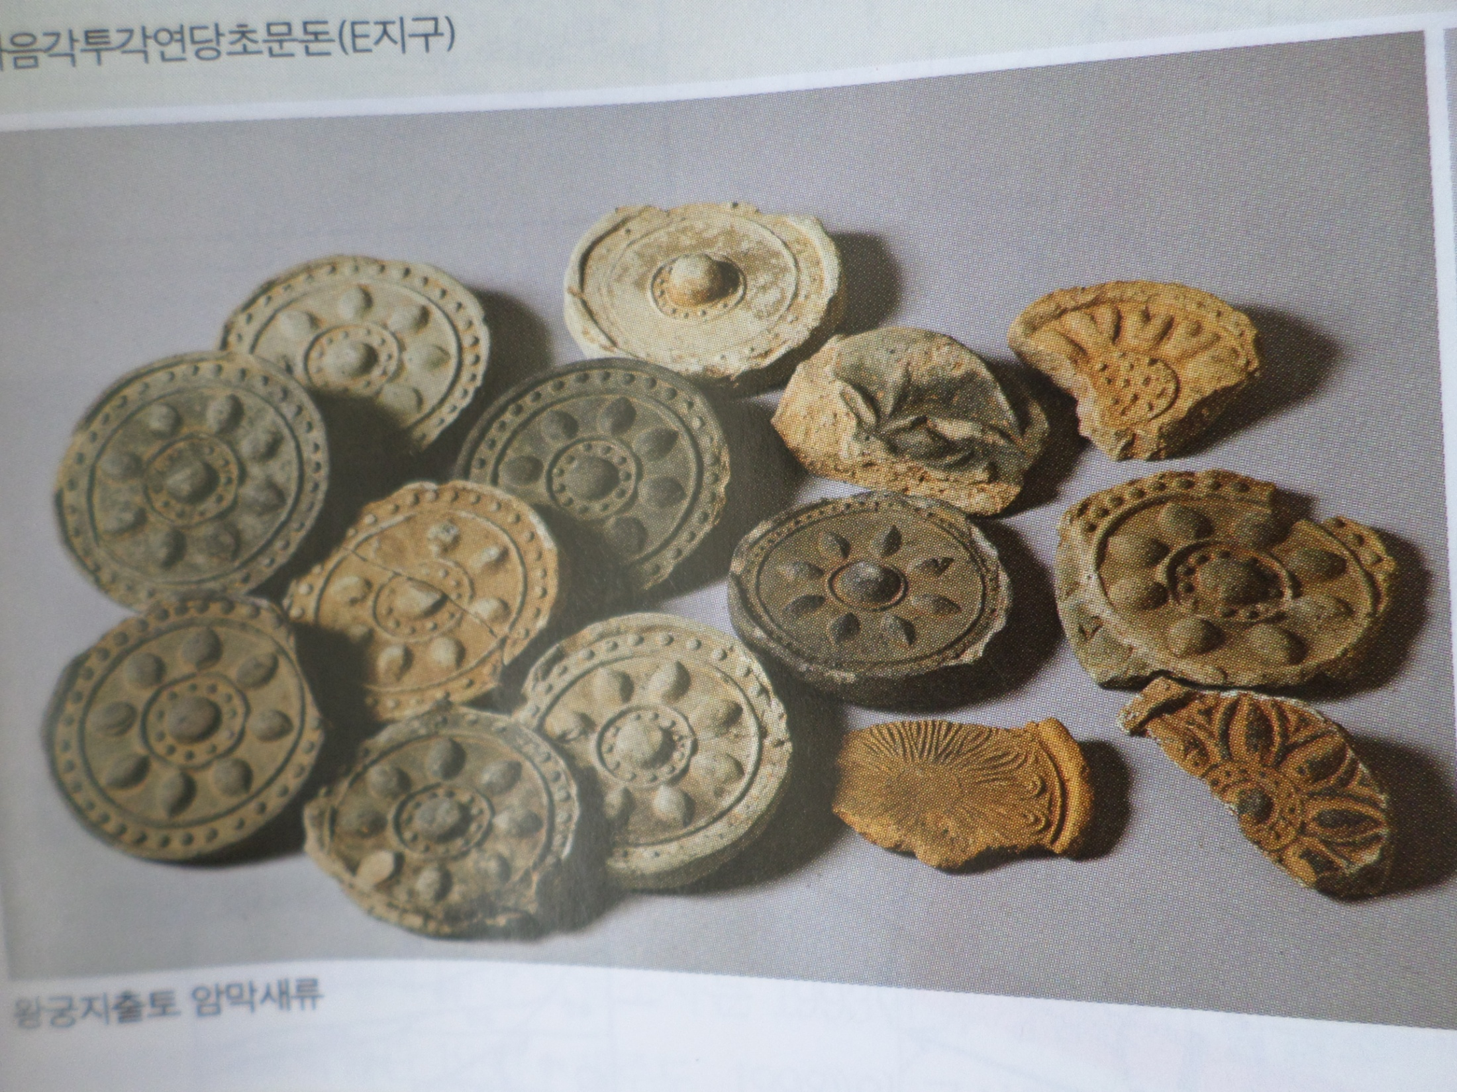

Slide 27
Jeju Island Hangpadu Fortress
In 1271, when Jindo Island was captured by the Ryeo-Mon (Goryeo-Mongol) allied forces, the Sambyeolcho led the remaining forces to enter Jeju Island and build it. Until 1273, it was a fierce battleground of the Great Mongolian Rebellion. In 1978, the restoration work of Hangpaduseong was carried out, and in 1997, it was designated as a historic site. In 1993, an excavation of the presumable southern gate was excavated, and in 2012, an earthen fortress was excavated. A survey of the inside of the fortress was conducted from 2010 to 2015, and more than 250 materials from 20 building features were secured.

Slide 28
As a result, it was revealed that a three-layered defence system was being built, including the Hwanhae Great Wall (first line of defence), intermediate defence facilities (second line of defence), and it was found that they were building a triple defence system, including Hangpadu Fortress and inner wall castle. As for excavated artifacts, inlaid celadon (cover, chair, and pillow) from the end of the 13th century was found, and ceramics from the Yuan Dynasty was also confirmed. The relic that draws attention is the roof tile inscribed 「敦眉瓦草造辛丑2月日高內村徒上吳」, which is dated to the year of 1241.

Slide 29
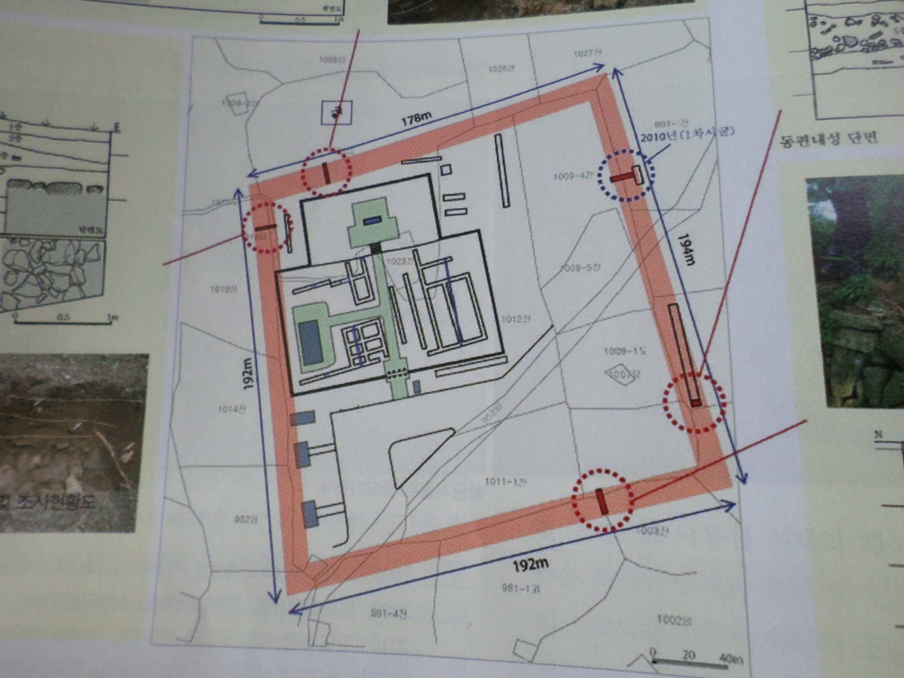

Slide 30
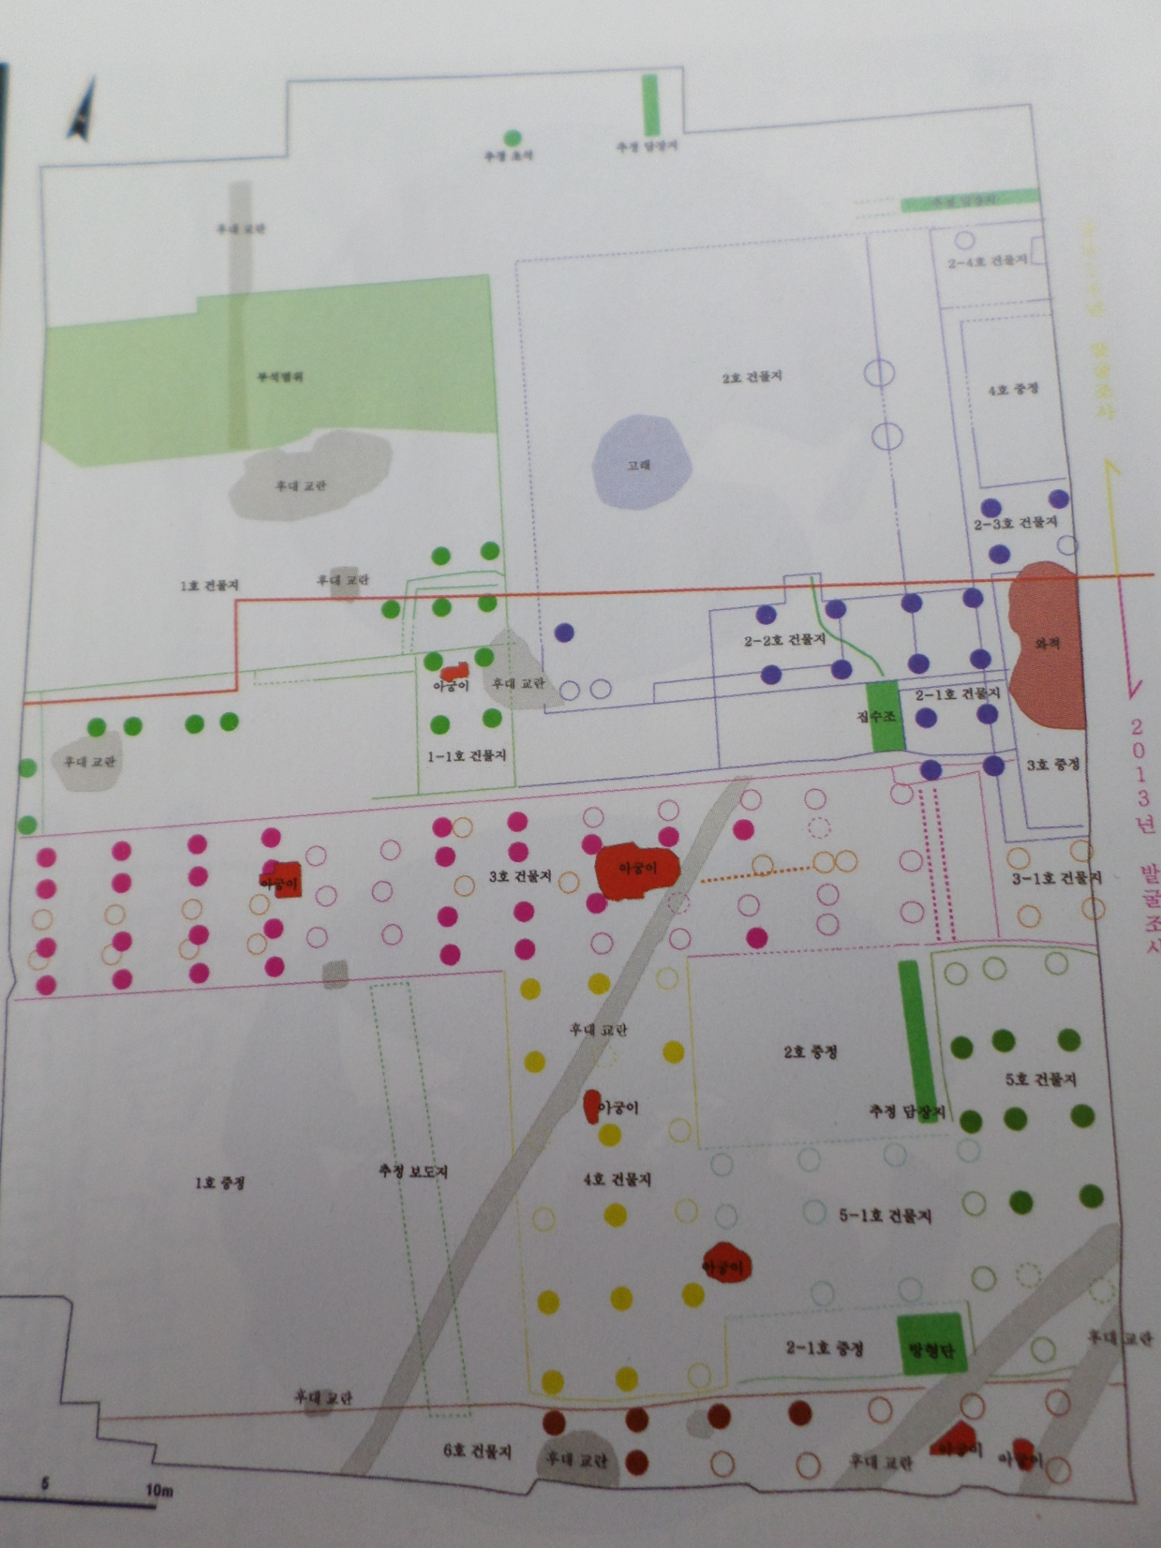

Slide 31
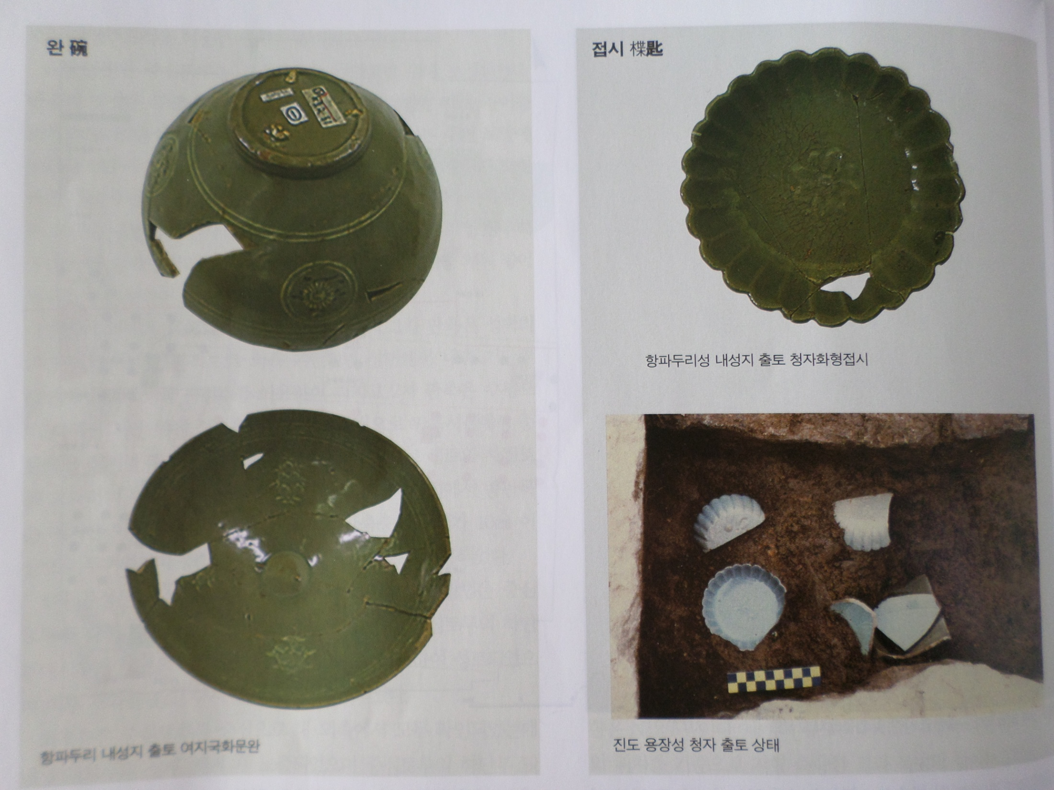

Slide 32
Ryukyu (now Okinawa, 流求)
A large roof tile from 「癸酉年高麗瓦匠造」 is excavated from a terraced defence facility called ‘Gusk’. There are several theories... The position that the date is set in 1273 suggests that Sambyeolcho's activities were carried out in Ryukyu after Jeju Island based on the similarity with the roof-end tile of Yongjangsanseong Fortress in Jindo Island.

Slide 33
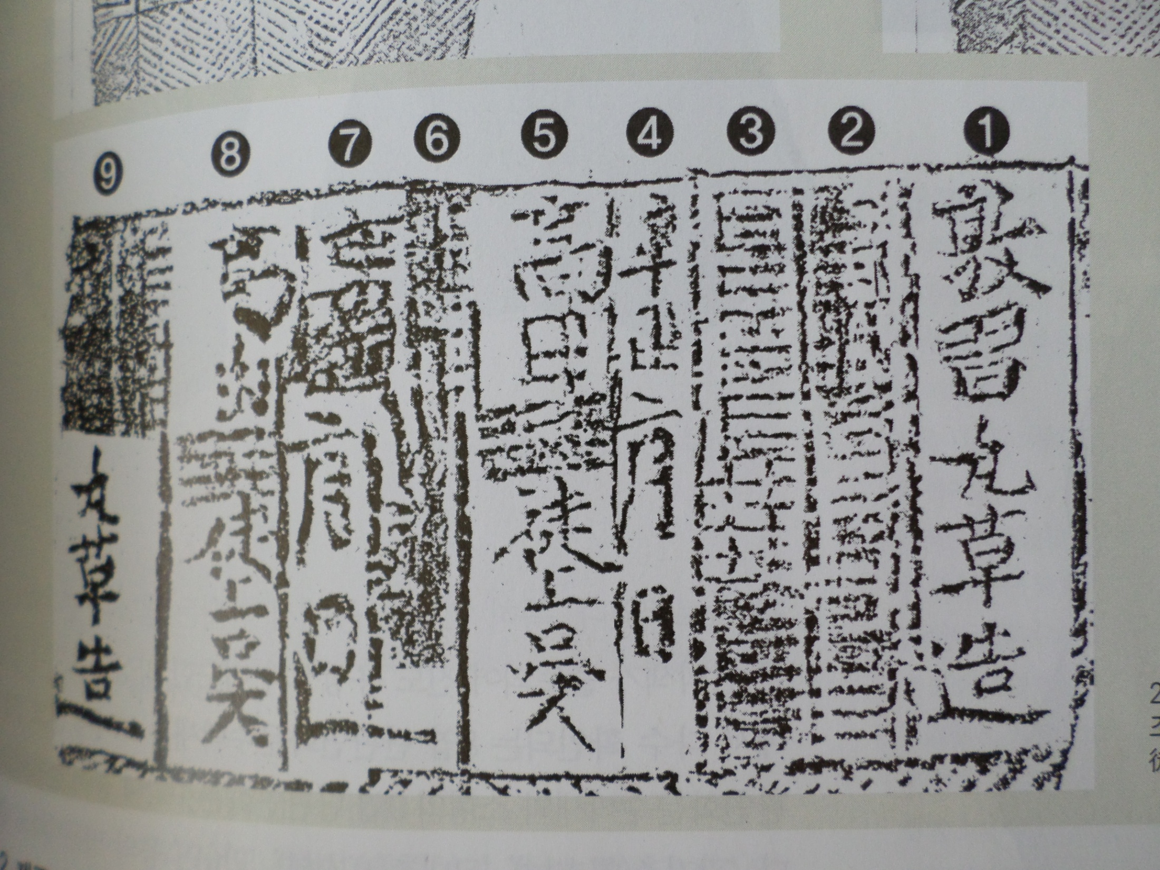

Slide 38
GORYEO-MONGOL ALLIED EXPEDITION TO JAPAN
Historical Background
First round (October 1274) it was Kamakura bakufu (鎌倉幕府) shogun (將軍). Monggoseuprae (蒙古襲來). A total of 40,000 expeditions, with Kim Bang-gyeong’s 8,000 combat soldiers, 6,700 non-combatants, 25,000 Heundo (Hundun) and Hong Da-gu‘s combatants, were organized. 900 battle ships were mobilized, including the Cheonryoju (front vessel), the Baldorogyeongjilju (landing vessel), and the Geupsuju (supply/connection vessel). They returned with the loss of one third of their troops.

Slide 39
Second round (1281): conquered the Southern Song in 1279. Kublai Khan prepared for the conquest of Japan in earnest, Beom Mun-ho, a native of Southern Song, sent a personal letter to Japan recommending surrender. In 1280, an order was issued to build 3,500 warships, and Arahant and King Chungryeol took responsibility for the Jeongdonghaengseong. In May 3, 1281, 42,000 Dongro Troops and 100,000 Gangnam Troops mobilized, and in July 30, they were hit by a typhoon (Kamigajae). The court of Yuan Dynasty tried to launch the third expedition to Japan; but the expedition was stopped due to the death of Kublai Khan, who prompted the 3rd expedition to Vietnam.

Slide 40
1274

Slide 41
Mongol Soldiers and Japanese on ship

Slide 42
1281

Slide 43
Mongol & Goryeo Troops in Japan

Slide 44
Mongol Soldiers and Japan Samurai

Slide 45
Archaeological Data
Archaeological data
In Japan, an underwater archaeological investigation was started in the Takashima area in 1980 to investigate the Mongol invasion. In 1981, the area of 7.5 km along the southern coast of Takashima and 200 m in the sea area was designated as a cultural property distribution area. Four wooden anchors equipped with anchor stones were unearthed during the excavation of Kanzaki Port embankment construction in 1994-95, and they can be classified as large or small. About 1,000 artifacts were recovered during the port construction of Kanzaki Port in 2001-02. Artifacts such as jars, pottery, knives, bows, no (crossbow), arrows, lacquerware for armor, decorative hardware, and coins were found. In particular, the figurative product made of earthenware seems to be an explosive bomb marked as iron cannon in the ‘Monggoseupraehoesa (蒙古襲來繪詞)’, a documentary painting of the Kamakura period. In 2006, Matsuura City (松浦市) showed interest and conducted an investigation, and in 2012, the area was designated as a national historic site.
In Japan, an underwater archaeological investigation was started in the Takashima area in 1980 to investigate the Mongol invasion. In 1981, the area of 7.5 km along the southern coast of Takashima and 200 m in the sea area was designated as a cultural property distribution area. Four wooden anchors equipped with anchor stones were unearthed during the excavation of Kanzaki Port embankment construction in 1994-95, and they can be classified as large or small. About 1,000 artifacts were recovered during the port construction of Kanzaki Port in 2001-02. Artifacts such as jars, pottery, knives, bows, no (crossbow), arrows, lacquerware for armor, decorative hardware, and coins were found. In particular, the figurative product made of earthenware seems to be an explosive bomb marked as iron cannon in the ‘Monggoseupraehoesa (蒙古襲來繪詞)’, a documentary painting of the Kamakura period. In 2006, Matsuura City (松浦市) showed interest and conducted an investigation, and in 2012, the area was designated as a national historic site.

Slide 46
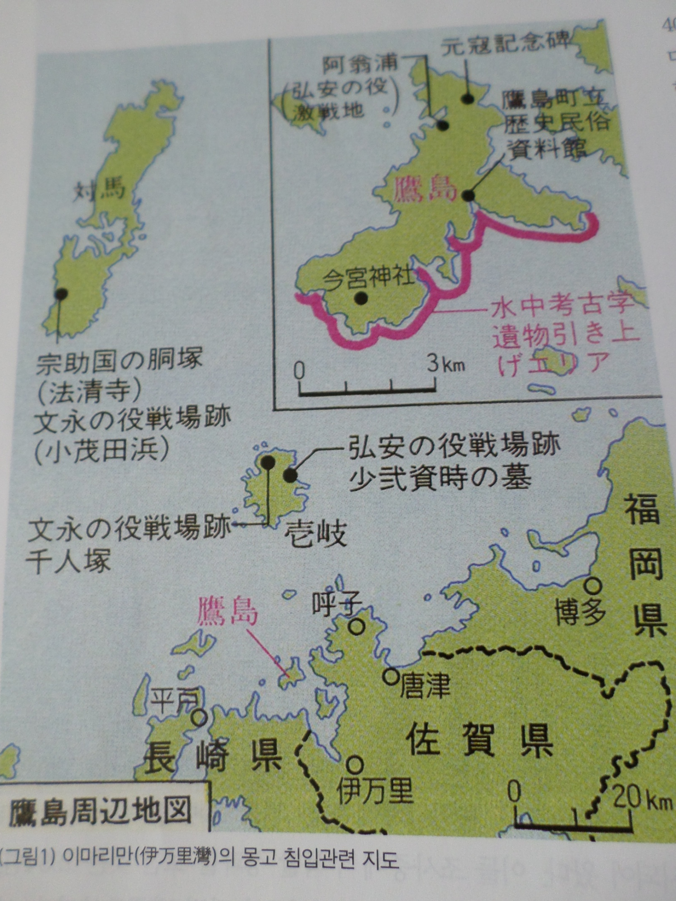

Slide 47
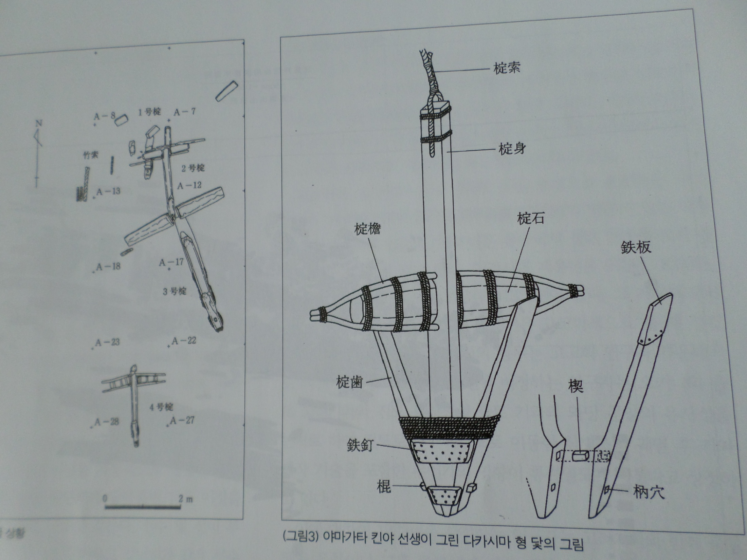

Slide 48
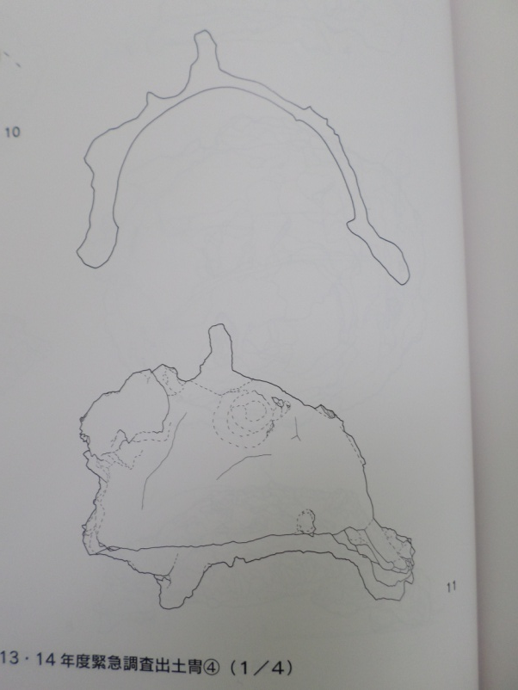
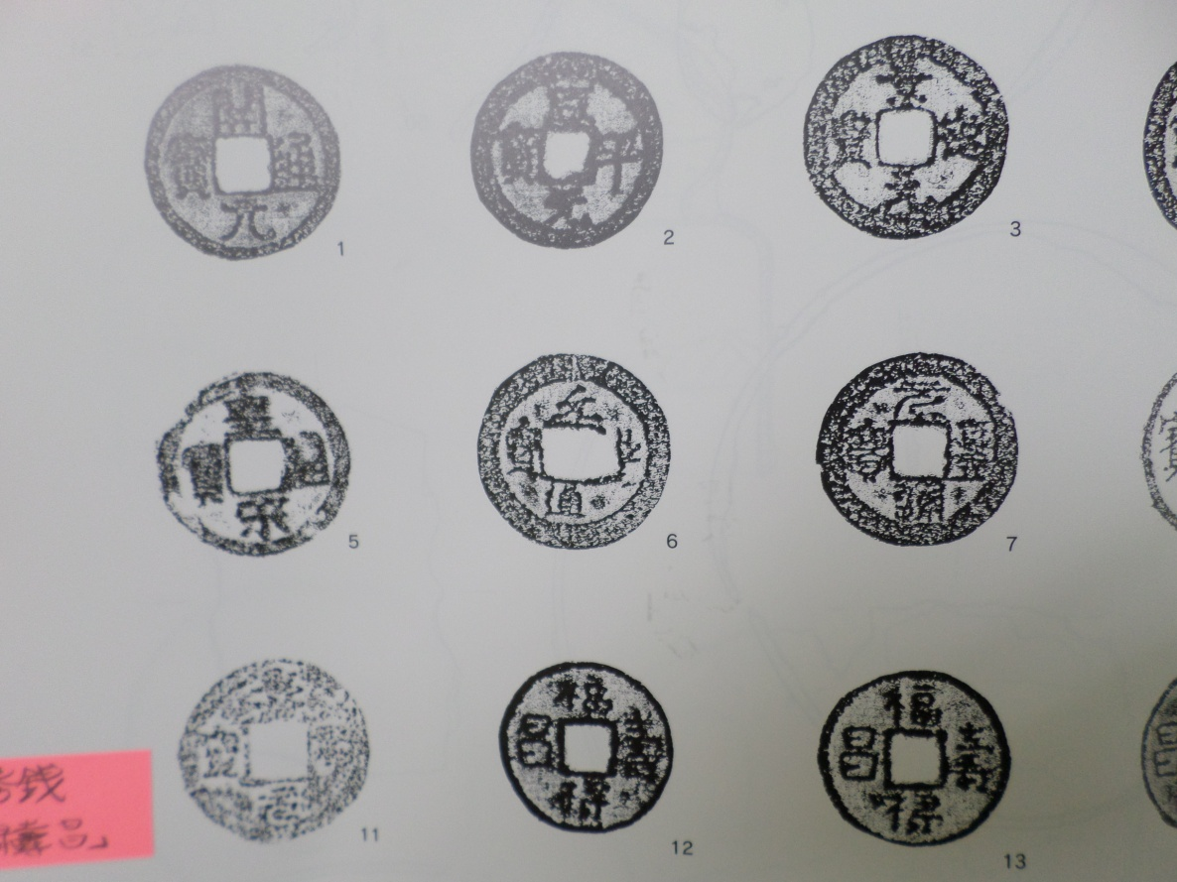
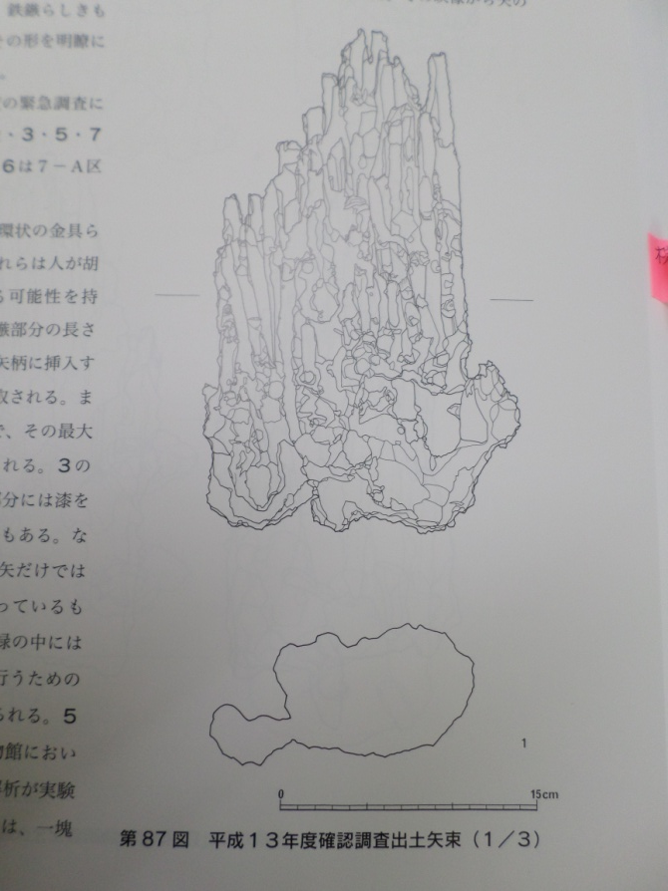

Slide 49
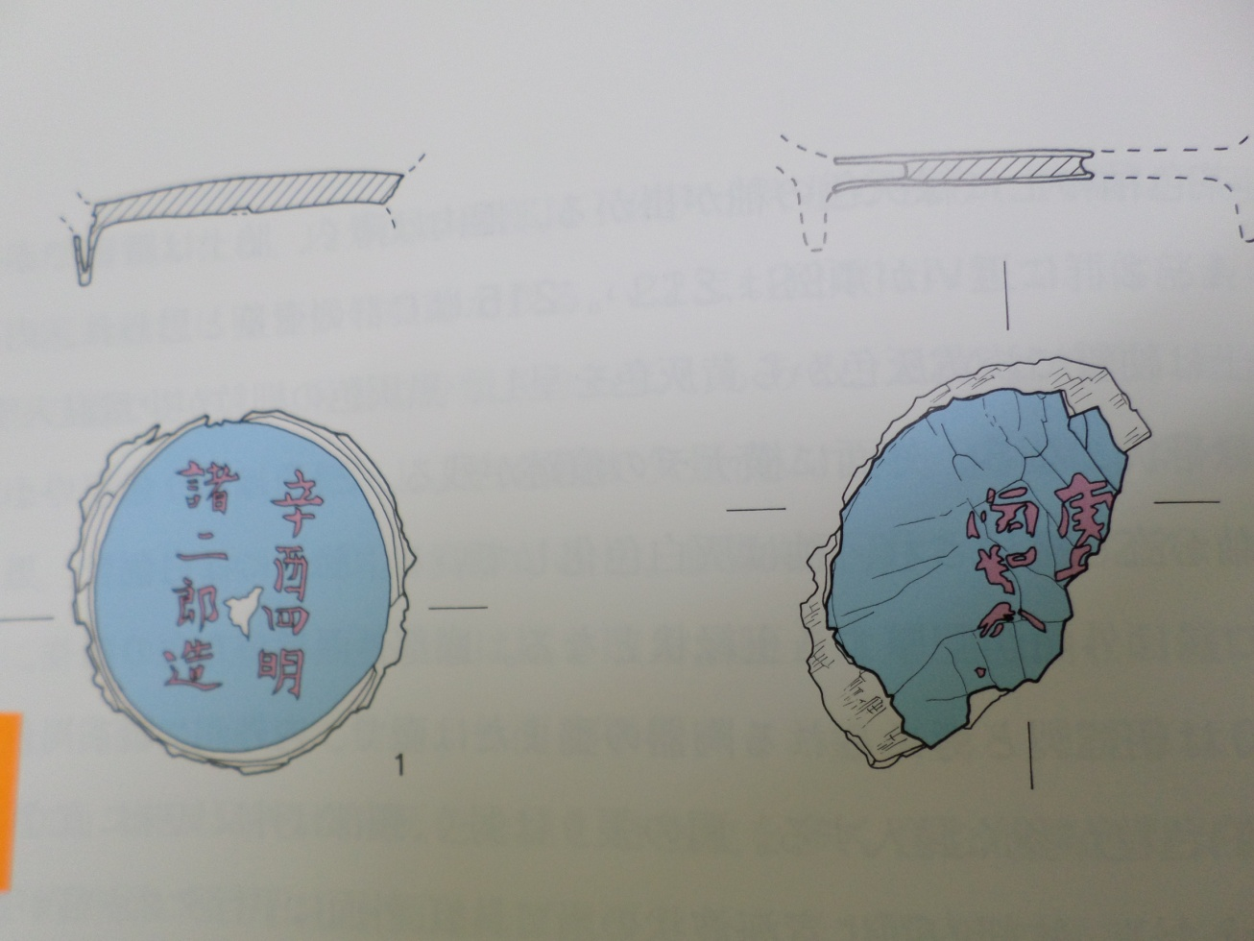

Slide 50
Professor Yoshifumi Ikeda (池田榮史) of the University of the Ryukyus has been involved in underwater archaeological excavation since 1992, and in 2005 independently conducted sonar surveys and made submarine topographical and geological maps. Based on these achievements, the 'Takashima sunken ship 1' in 2011-12 and the 'Takashima sunken ship 2' were excavated and investigated in 2014-15. Judging from the structure of the hull and the excavated artifacts, it was identified as a ship sunk during the Mongol expedition to Japan in the thirteenth century.

Slide 51
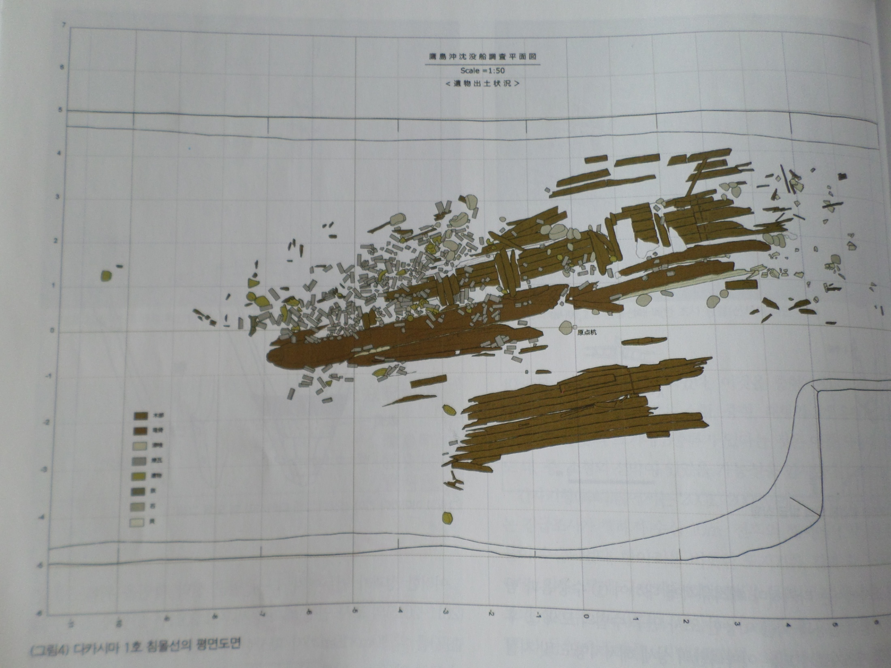

Slide 54
CONCOLUDING REMARKS
: Celebrating the 701 st Anniversary of the Sinan Ship's Departure
The Mongols, a nomadic empire, was aware of the importance of the sea, and the Mongols organized the manpower of the occupied territories into the Mongolian army. The government actively supported Saekmok people so that they could engage in trade with preferential treatment, and maximized their efforts to become a maritime power by making Jeju Island their direct jurisdiction in marine management.

Slide 55
In the 60 years of war between the Mongols and the Goryeo, from the military regime of Goryeo to the resistance of Sambyeolcho, the events that took place on the stage from Gaegyeong-Ganghwa Island-Jindo Island-Jeju Island-Ryukyu take on the aspect of an international war. The material that shows the Mongols (Yuan Dynasty)’ active maritime activities is the Sinan Ship. It was a trading ship going from Ningbo, China to Japan via Goryeo in 1323. A vessel with a length of 34 m, a width of 11 m and a total weight of 200 tons, 20,000 pieces of ceramics, 8 million coins, and 1,000 pieces of rosewood were revealed. In October 2016, a special exhibition was held at the National Institute of Maritime Cultural Heritage (40 years of underwater excavation in Korea). There is a great need to recognize the Sinan Ship as a ship of the Mongol Empire, not a ship of China. This year, 2024, marks the 701 st anniversary of the departure of the Mongol Empire ship ‘Sinan’ from the Yuan Dynasty. Thank you very much.

Slide 56
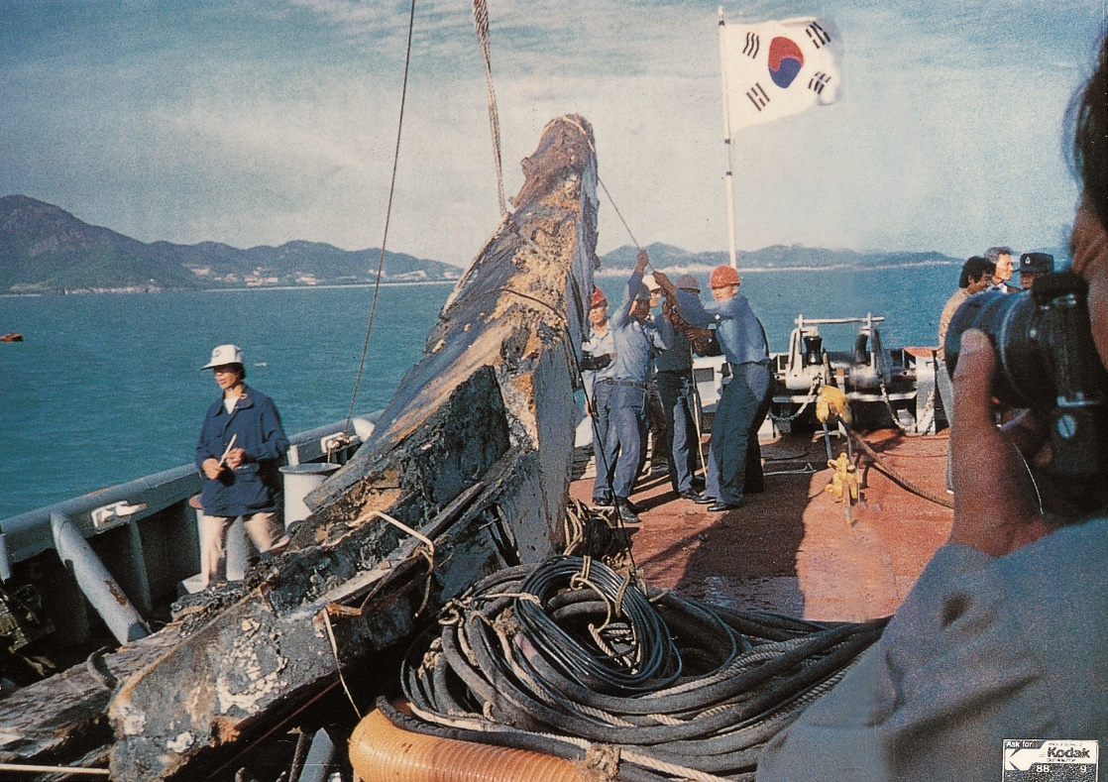
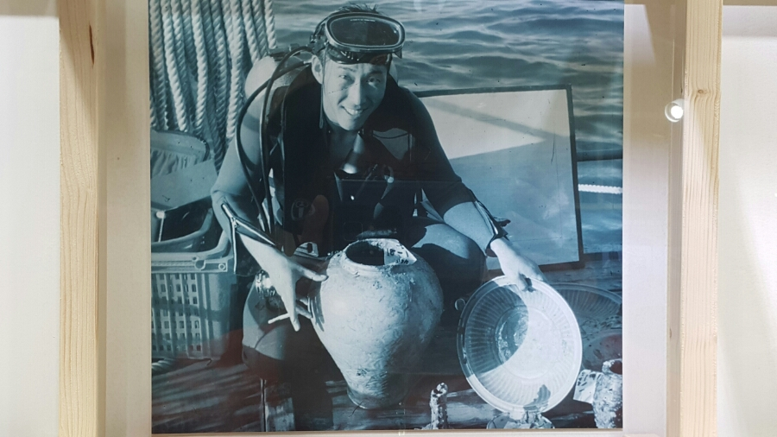
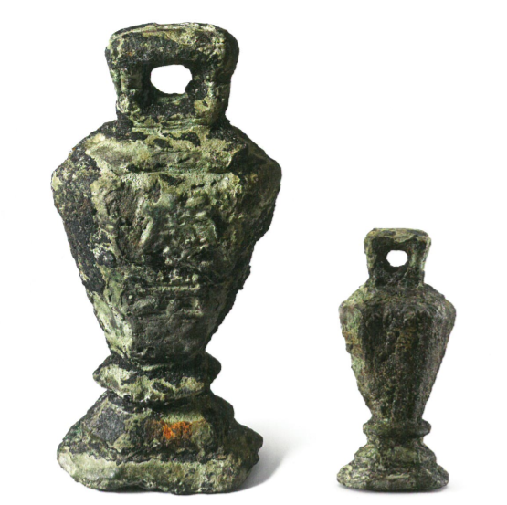
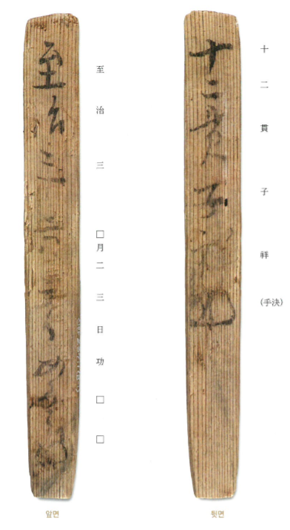
Diver-Navy
慶元銘
1323

Slide 57
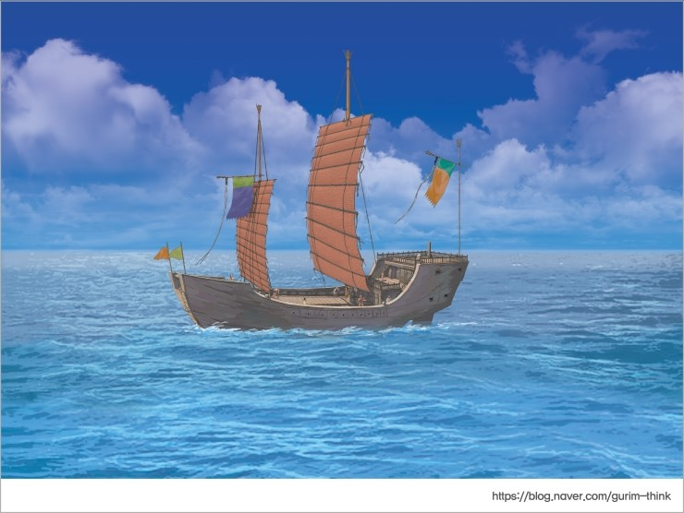
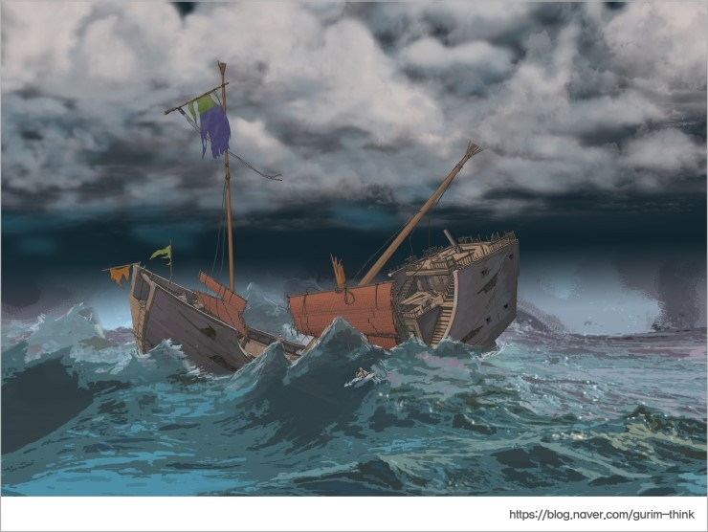
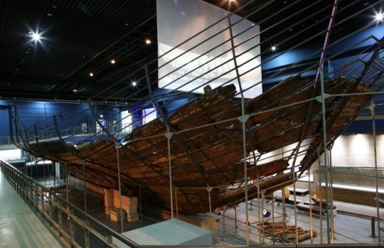
Mongol Empire(元) Ship Shinan Shipwreck in Korea
Mokpo City
1323

Slide 58
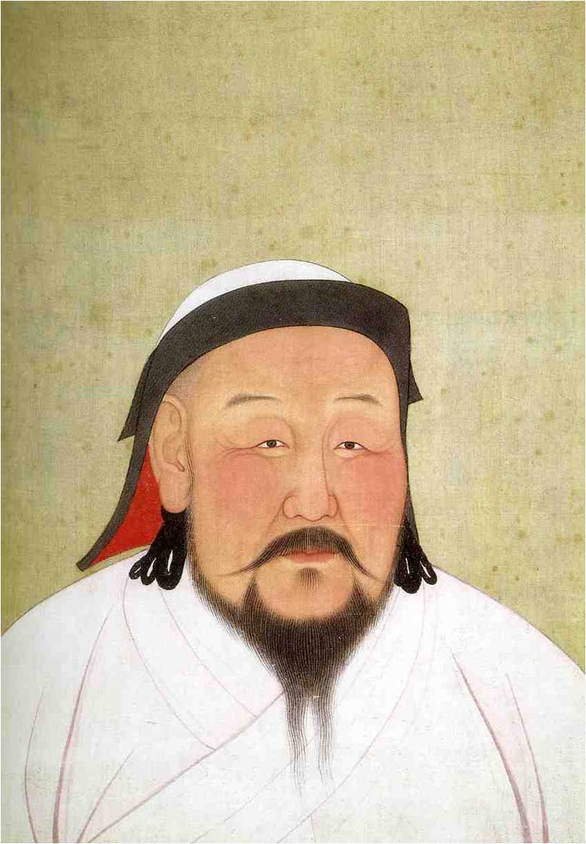
Trans-Altai Sustainability Dialogue : Peace, Justice, and Strong Institutions
25th April 2024
The Archaeological Type
of Sambyeolcho,
Goryeo Dynasty
in Korean Peninsula
and the Route of
Mongol Empire Military Force
윤 형 원(국립김해박물관장)
Yun Hyeung-won (Yundorj)
ㅇ Director, The National Museum
of Korea in Gimhae
ㅇ Previous Chairman(2019-2022),
The Korean Association for
Central Asian Studies(KACAS)

