Slide 1
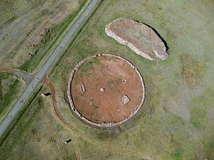
Language Evolution and Human History around the Altai Mountains: Scytho-Siberians, Xiongnu, and the local populations Attila Mátéffy (University of Bonn) TRANS-ALTAI SUSTAINABILITY DIALOGUE- SDG 16: PEACE, JUSTICE, AND STRONG INSTITUTIONS Section 5: Global Studies of the Altaic Language(s) State Palace, Ulaanbaatar, Mongolia 25-26 April 2024

Slide 2
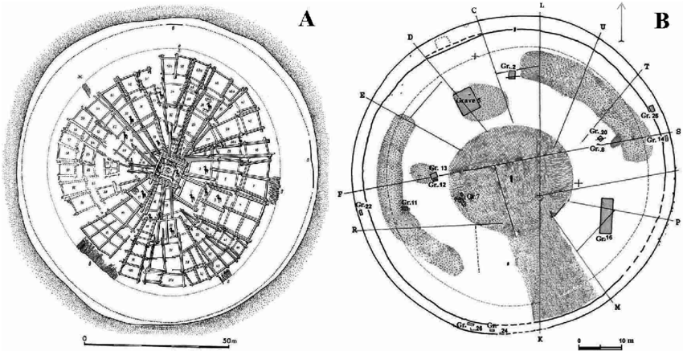
Linguistics, Anthropology, Archaeology, and Genetics
“Historical inference is at its most powerful when independent lines of evidence can be integrated into a coherent account. Dating linguistic and cultural lineages can potentially play a vital role in the integration of evidence from linguistics, anthropology, archaeology, and genetics. […]”
(Gray, Atkinson & Greenhill 2011: 1090)
Mong. khirigsuur [Хиргисүүр] ~ Hung. kereksír ‘round grave’; Hung. ‘sürásóknak’ (1543 CE; MNy. 56: 384; TESZ III, 1976: 546–547)
By contrast: Georg 2002, 2004, 2005, etc.; Vovin 2000, 2009, etc.
The architectural style of the Arzhan-1
(A; 8-9th centuries BCE) & Arzhan-2
(B; 7th centuries BC) barrows

Slide 3
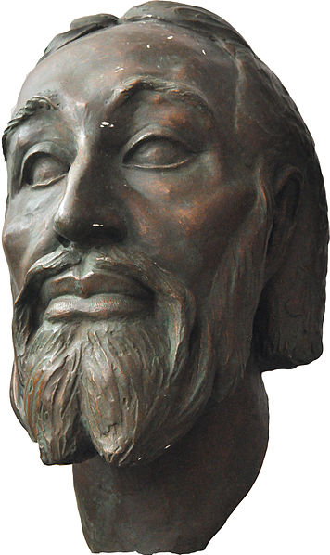
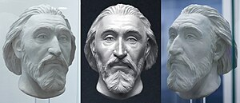
R1a1a1b2-Z93 haplogroup (Hg R1a-Z2125): The Genetic Evidence of the Scytho-Siberian/Xiongnu Origin of the First Hungarian Royal Dynasty (so-called Árpád Dynasty; correctly: Turul Kindred)
TUK45 – Tamir Ulaan Khoshuu cemetery in Central Mongolia (Arkhangai Aimag; R1a-Z93) – Xiongnu, 1st century BC and the 1st century AD
“[…] a shared haplotype (14 Y-STR) between TUK-09A,-10 and King Béla III (1172–1196), […] a matching haplotype (15 Y-STR) between TUK-12,-35 and another male individual found in the Royal Basilica where King Béla III was buried (II/54). Individuals TUK-9A,-10,-18 and -23 also carried haplotypes similar to those carried by the tenth century Hungarian Conquerors (KEII/61 and NF/2) (Fóthi et al. 2020), […].”
(Keyser et al. 2021: 354)

Slide 4
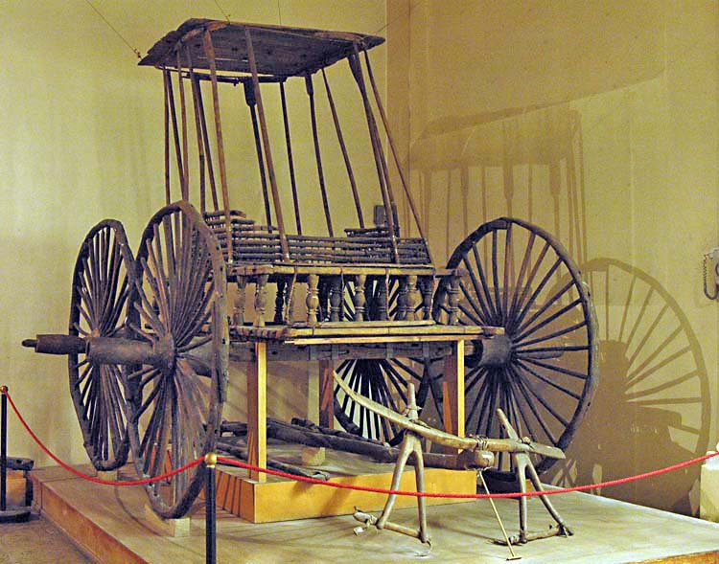
Scytho-Siberian (Eastern Iranian) Substrate (or Basis) of Hungarian Language
Verbal Prefixes – no parallels in the so-called “Uralic” and “Altaic” languages
Dual grammatical number
Case system – no parallels in the so-called “Uralic” languages
Syntax: compound-complex sentences
Phonology: labialized a [å]; Initial f-, r-, m-, n-; etc.
Vocabulary; e.g., arany, asszony, egész, ezer, ezüst, hét, híd, isten, kard, kutya, méh, méreg, méz, (1) nem, (2) nem, nemez, öreg, özvegy, ravasz, róka, reggel, régen, száz, szekér, tej, tehén, tíz, vár, vásár, zöld; etc.
Pazyryk chariot (Pazyryk kurgan, 3rd c. BCE, Altai Mountains)

Slide 5
Direct Proto-Hungarian (Northern Xiongnu) - Proto-Mongolian Language Contact
Mong. дээд ‘upper, top’ ~ Hung. déd- [dēd] ‘great [grandmother, grandfather]’
Mong. муужгай ‘kitten, pussy, pussycat’ ~ Hung. macska [mačka] ‘cat’
Mong. тэрэг ‘cart, wagon, carriage’ ~ Hung. tereh, teher ‘load, weight, charge’
Mong. тэргэнцэр ‘lorry, truck, trolley, cart’ ~ Hung. targonca [tårgontså] ‘truck, trolley, cart’
Mong. төв ‘center, main, epicenter, nucleus, etc.’ ~ Hung. tő [tȫ], töv ‘root, stem, radix’
Mong. сунагар ‘tall and slender [person], spindly’ ~ Hung. cingár [cingār] ‘tall and slender [person], spindly’
Mong. цээж ‘chest, breast’ ~ Hung. szegy [sed’] ‘breast, brisket (the chest of an animal)’
Mong. шилүүс ‘Lynx’ ~ Hung. hiúz [hiūz] ‘Lynx’
Mong. элээ ‘kite (a bird of prey)’ ~ Hung. ölyv ‘hawk, buzzard (a bird of prey)’
Etc.

Slide 6
Scytho-Siberian (Eastern Iranian): a Substrate Language of Hungarian and the Turkic Languages?
“Most linguists and historians agree that Proto-Turkic, the common ancestor of all ancient and contemporary Turkic languages, must have been spoken somewhere in Central-East Asia (e.g. Róna-Tas, 1991, p. 35; Golden, 1992, pp. 124–127; Menges, 1995, pp. 16–19). […]” (Uchiyama et al. 2020: 11)
“The Proto-Turkic habitat can be viewed as an ecological junction area on the boundary of the NEG and the steppe. Linguistically, this diversity is mirrored in the contact history of Proto-Turkic, which included interactions with both the languages of the steppe, such as East Iranian and Tocharian, and the languages that are associated with the northern forest zone, such as Samoyedic and Yeniseian (Dybo, 2007, pp. 115–169).” (Uchiyama et al. 2020: 12)
“[…] According to some accounts (e.g. Dybo 2007, pp. 116–117), a number of Proto-Turkic pastoralist terms were borrowed from Indo-European and, specifically, Eastern Iranian (e.g. *tạ̄na ‘heifer’, cf. Khotan Saka dīnū ‘cow’ of Iranian origin).” (Uchiyama et al. 2020: 13)

Slide 7
whale < Old English hwæl < Proto-Germanic *hwalaz < Proto-Indo-European *(s)kwal-o- "large sea fish"

Slide 8
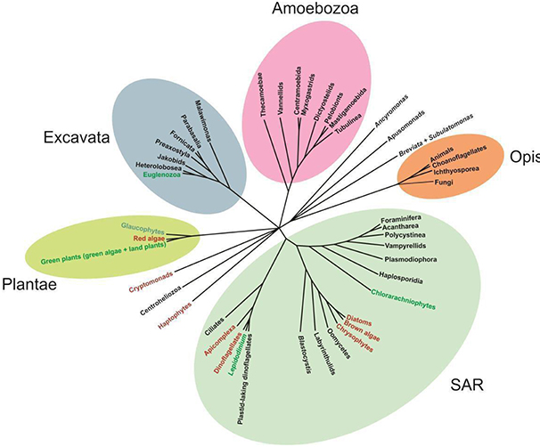
Unrooted Phylogenetic Trees

Slide 9
Conclusions
the integration of evidence from linguistics, anthropology, archaeology, and genetics
R1a1a1b2-Z93 haplogroup (Hg R1a-Z2125): The Genetic Evidence of the Scytho-Siberian/Xiongnu Origin of the First Hungarian Royal Dynasty
Language is NOT monolithic / Cultural Evolution is NOT monolithic
Langauges are NOT organisms with body (Enfield 2014: 326) – There are NO “language families” but nonlinear Complex Adaptive Systems (CAS)
Hungarian language has a massive, while Turkic languages have a less salient Scytho-Siberian (Eastern Iranian) substrate or basis.
Hungarian and Turkic languages are mixed languages (conf.: Matras & Bakker 2003): an Eastern Iranian core & polyphyletic Inner Asian (Mongolic, Samoyedic, Yeniseian, etc.) superstrata

Slide 10
Selected Literure
Enfield, N. J. 2014. Transmission biases in the cultural evolution of language: toward an explanatory framework, 325–335. In: Dor, D., C. Knight, and J. Lewis (eds.), The Social Origins of Language. Oxford University Press.
Gray, R. D., Q. D. Atkinson & S. J. Greenhill. 2011. Language Evolution and Human History: what a difference a date makes. Philosophical Transactions of the Royal Society B, 366: 1090–1100.
Keyser, C., V. Zvénigorosky, T. Tsagaan, E. Crubézy, et al. 2021. Genetic evidence suggests a sense of family parity and conquest in the Xiongnu Iron Age nomads of Mongolia. Human Genetics, 140: 349–359.
Lee, J.-Y. & S. Kuang. A Comparative Analysis of Chinese Historical Sources and Y-DNA Studies with Regard to the Early and Medieval Turkic Peoples. Inner Asia, 19 (2), 197–239.
Mary, L., V. Zvénigorosky, C. Keyser, et al. 2019. Genetic kinship and admixture in Iron Age Scytho-Siberians. Human Genetics, 138 (4): 411–423.
Matras, Y. & P. Bakker (eds.). 2003. The Mixed Language Debate: Theoretical and Empirical Advances. Berlin & New York: Mouton de Gruyter.
Uchiyama, J., J. C. Gillam, A. Savelyev, C. Ning. 2020. Population dynamics in Northern Eurasian forests: a long-term perspective from Northeast Asia. Evolutionary Human Sciences, 2 (e16): 1–19.
Unterländer, M. et al. 2017. Ancestry and demography and descendants of Iron Age nomads of the Eurasian Steppe. Nature Communications, 8: 14615.
Vovin, A. 2000. Did the Xiongnu Speak a Yeniseian Language? Central Asiatic Journal, 44 (1): 87–104.

